Slide 1
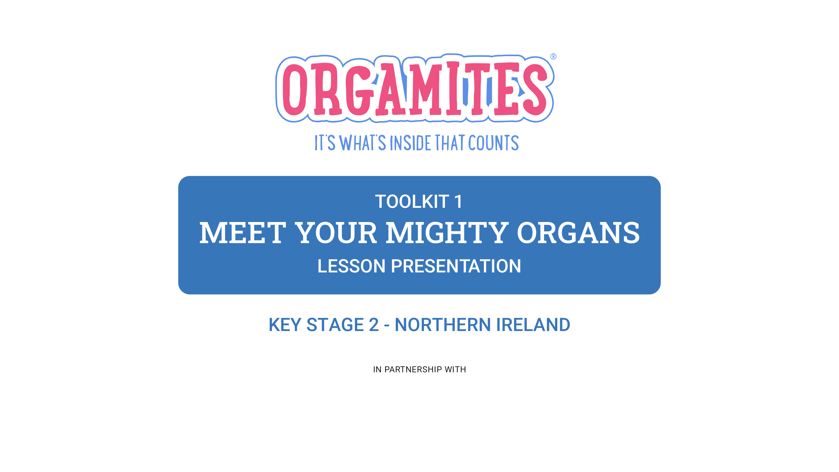


Orgamites ® is an organ donation education and awareness programme created by Roydon Turner. Creative and production by All Good Co. (CIC) © Copyright 2016. All rights reserved.
TK1: LESSON PRESENTATION

Slide 2
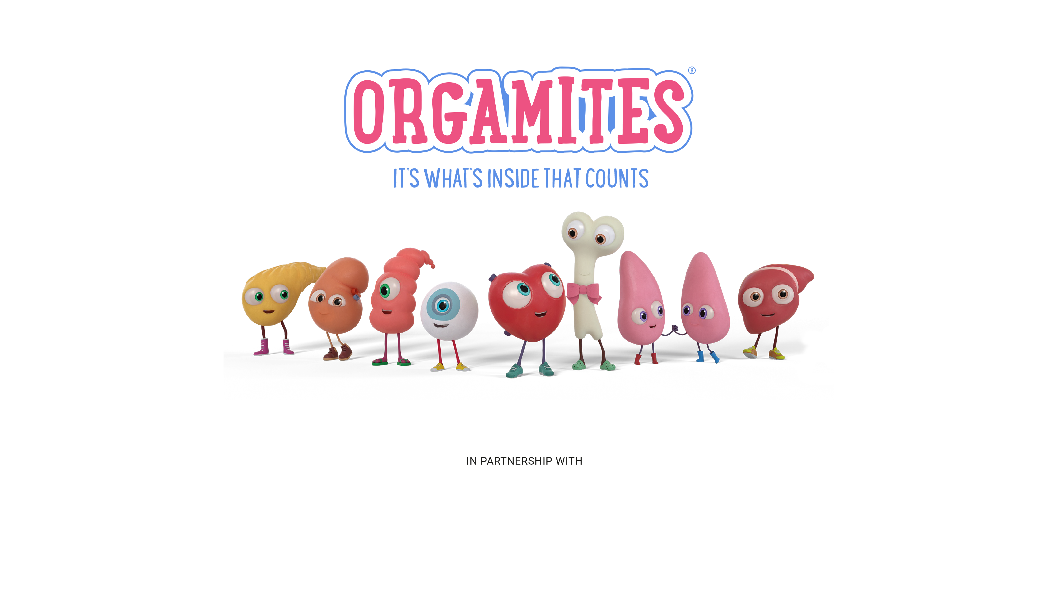
In this lesson pupils identify different organs and learn about their role in the human body, before exploring organ donation and how it can positively impact people’s lives.
Orgamites ® is an organ donation education and awareness programme created by Roydon Turner. Creative and production by All Good Co. (CIC) © Copyright 2016. All rights reserved.
TK1: LESSON PRESENTATION

Slide 3
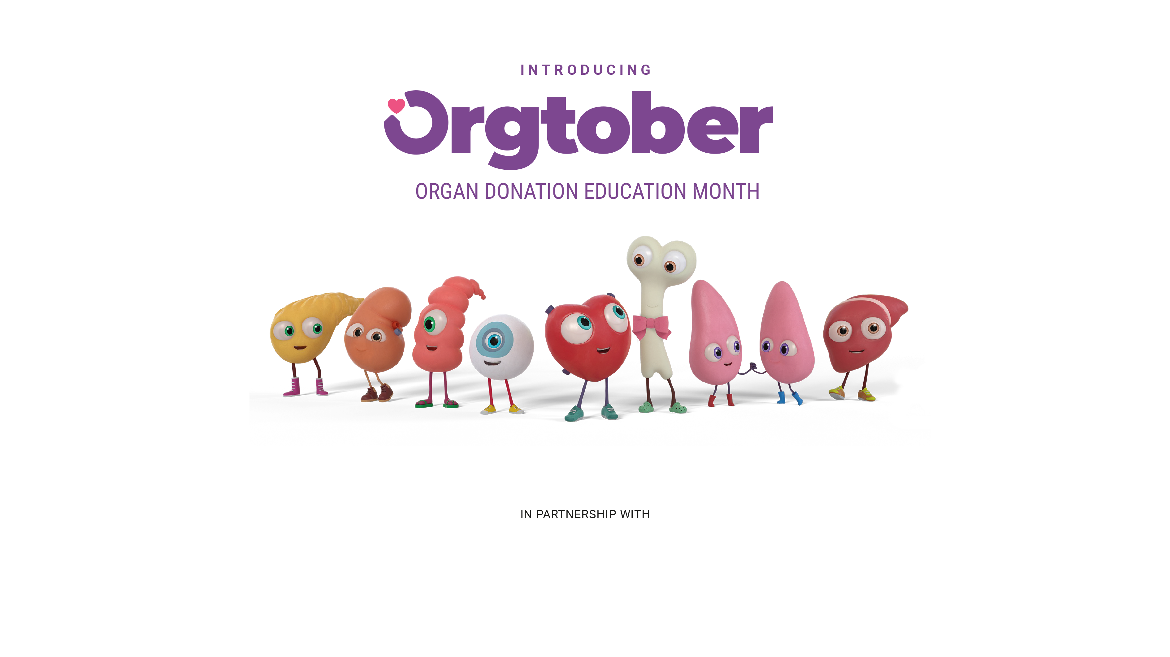
In this lesson pupils identify different organs and learn about their role in the human body, before exploring organ donation and how it can positively impact people’s lives.
Orgamites ® is an organ donation education and awareness programme created by Roydon Turner. Creative and production by All Good Co. (CIC) © Copyright 2016. All rights reserved.
TK1: LESSON PRESENTATION
Notes:
What is Orgtober? Orgtober, formerly known as October, is our 'Organ Donation Education Month,' a month of activities, activations, and events all dedicated to promoting organ donation education among children, teachers, and families the world over.
By highlighting the importance of organ donation and encouraging more people to consider organ donation, we hope to create a worldwide movement that will impact generations to come and save countless lives too.

Slide 4
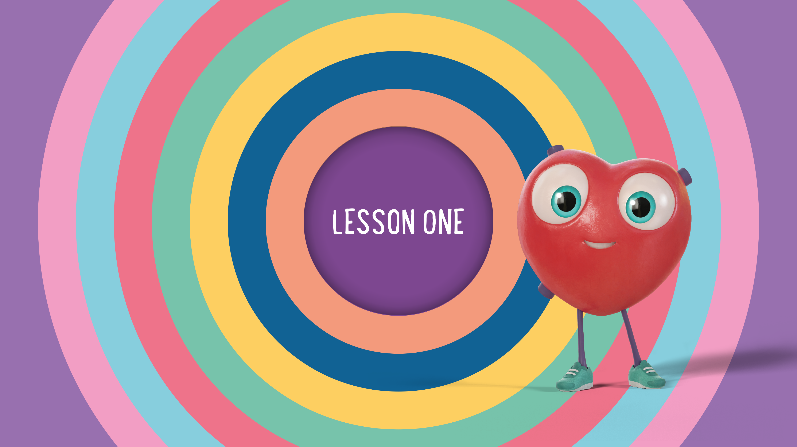
Orgamites ® is an organ donation education and awareness programme created by Roydon Turner. Creative and production by All Good Co. (CIC) © Copyright 2016. All rights reserved.
Orgamites ® is an organ donation education and awareness programme created by Roydon Turner. Creative and production by All Good Co. (CIC) © Copyright 2016. All rights reserved.
TK1: LESSON PRESENTATION
Notes:
Refer to Lesson Plan notes page 3

Slide 5
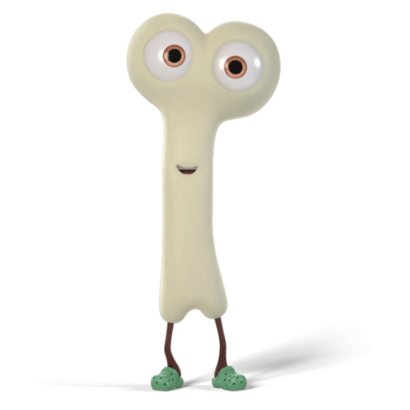
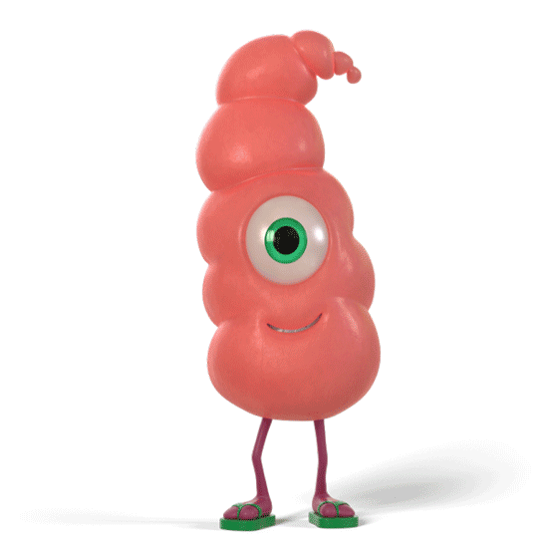
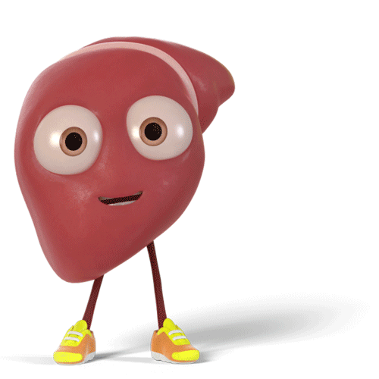
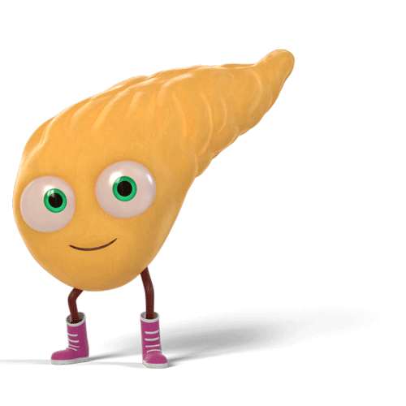
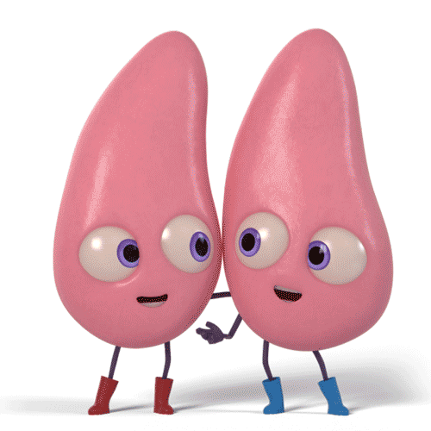
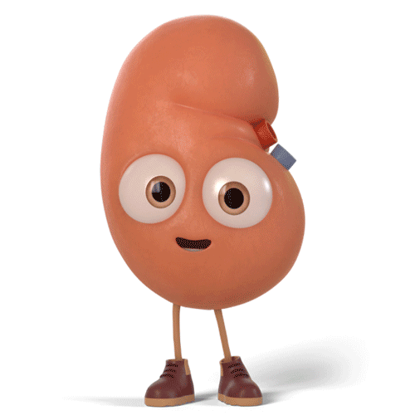
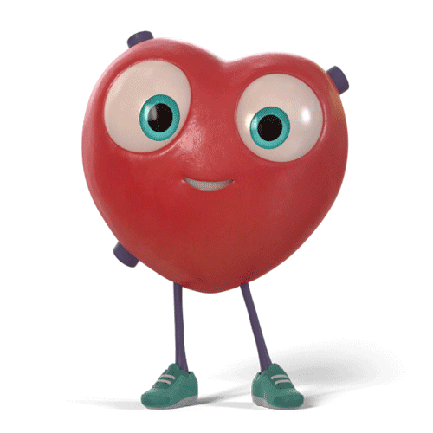
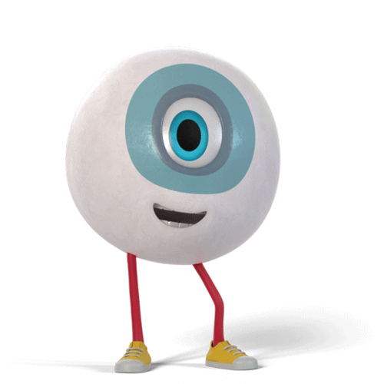
Are you ready to learn all about your organs?
Orgamites ® is an organ donation education and awareness programme created by Roydon Turner. Creative and production by All Good Co. (CIC) © Copyright 2016. All rights reserved.
TK1: LESSON PRESENTATION

Slide 6
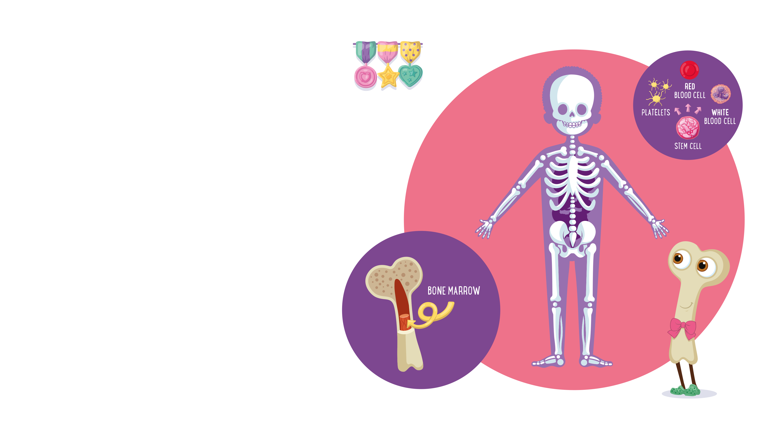
Meet Captain Marrow
Captain Marrow is the leader of the
Mighty Team. He can be found
throughout your body, holding you
up and giving your body shape.
His main job is to make the blood cells
you need to survive—about 500 billion
new ones every day!
Did you know?
Bone marrow is a thick, spongy kind
of jelly in the middle of most of your
bones which makes stem cells.
Orgamites ® is an organ donation education and awareness programme created by Roydon Turner. Creative and production by All Good Co. (CIC) © Copyright 2016. All rights reserved.
Orgamites ® is an organ donation education and awareness programme created by Roydon Turner. Creative and production by All Good Co. (CIC) © Copyright 2016. All rights reserved.
TK1: LESSON PRESENTATION
Notes:
Ask pupils where they think Captain Marrow (bone marrow) is located in the human body.
Further information
The human body contains over 200 bones. Our bones have many important functions, from supporting our body to protecting the organs and allowing you to move. They also contain bone marrow which has the very important job of creating blood cells.
Bone marrow is mostly found in the flat bones such as the hip bone, breast bone, skull, ribs, vertebrae and shoulder blades. It is also found at the end of the long upper arm bone (the humerus, pronounced ‘hyoo-muh-ruhs’) and the thigh bone (the femur).
Did you know?
When you are born, you have about 300 bones, but these slowly fuse or ‘grow together’ as you get older.

Slide 7
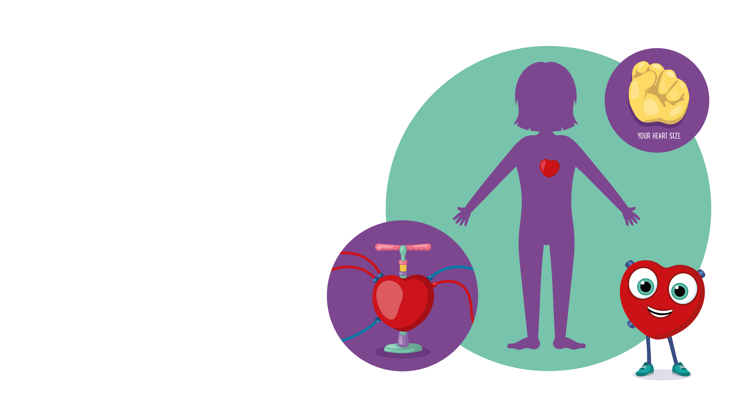
Meet Heart
This mighty organ does everything with a steady rhythm. Heart pumps blood filled
with oxygen and nutrients through a
maze of tubes called arteries and veins.
Did you know? The beat goes on and
on and on! Your heart beats around
100,000 times every day and around
three billion times in a lifetime!
Put a hand on your heart right now.
Can you feel the beat?
Orgamites ® is an organ donation education and awareness programme created by Roydon Turner. Creative and production by All Good Co. (CIC) © Copyright 2016. All rights reserved.
Orgamites ® is an organ donation education and awareness programme created by Roydon Turner. Creative and production by All Good Co. (CIC) © Copyright 2016. All rights reserved.
TK1: LESSON PRESENTATION
Notes:
Ask pupils where they think the heart is located in the human body.
Further information
The heart is found in the chest, between the lungs but slightly to the left of the chest. Like the lungs, the heart is protected by the rib cage.
The average heart is about the size of a human fist and can pump between 5 and 7 litres of blood every minute.
Together, the heart blood vessels and blood make up the body’s circulatory system, which has the important job of keeping the blood moving around your body.
Did you know?
On average, men’s hearts weigh slightly more than women’s, but women’s hearts beat at a slightly faster rate than men’s.

Slide 8
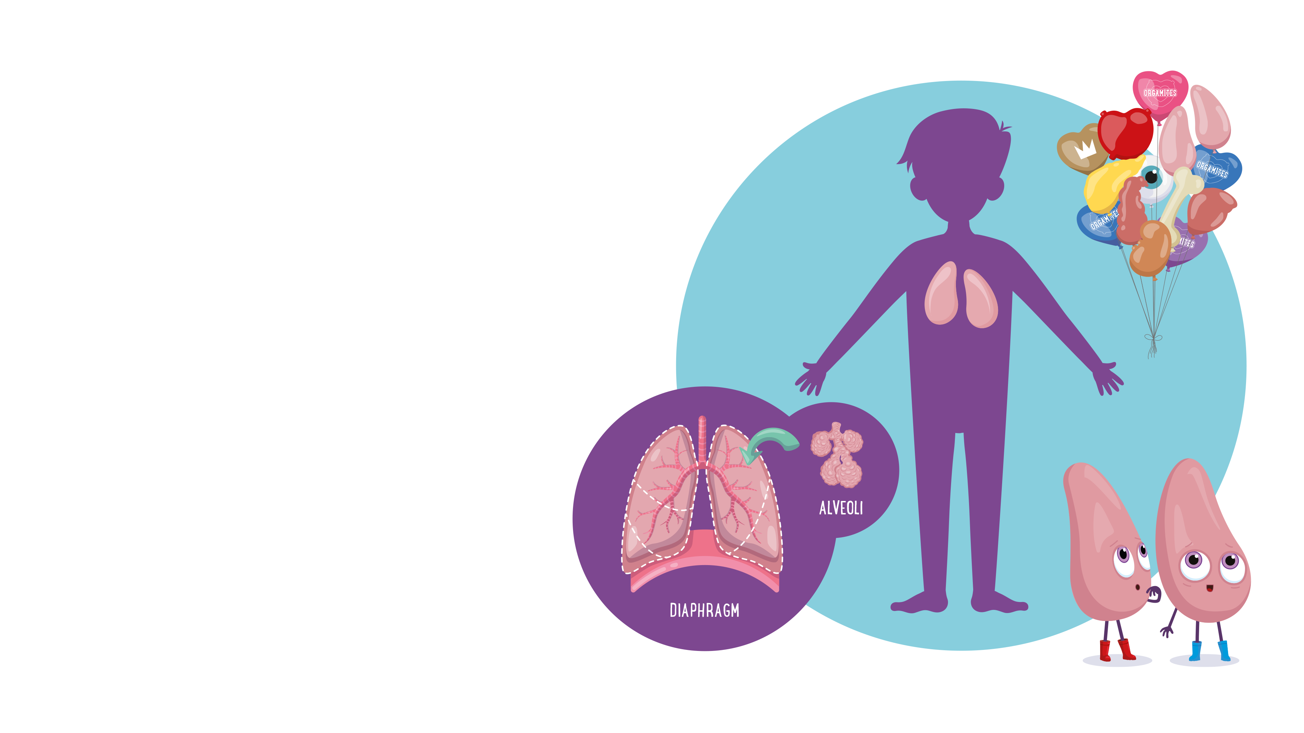
Meet the Lungs
These mighty organs always stick together. They transport oxygen from the air you
breathe into your bloodstream and take
away carbon dioxide when you breathe out.
The alveoli at the end of your bronchioles
are like lots of tiny balloons.
Did you know? A large lung capacity
means you can send oxygen around
your body faster. You can do this
by exercising regularly.
Orgamites ® is an organ donation education and awareness programme created by Roydon Turner. Creative and production by All Good Co. (CIC) © Copyright 2016. All rights reserved.
Orgamites ® is an organ donation education and awareness programme created by Roydon Turner. Creative and production by All Good Co. (CIC) © Copyright 2016. All rights reserved.
TK1: LESSON PRESENTATION
Notes:
Ask pupils where they think the lungs are located in the human body.
Further information
The lungs are a pair of spongy, air-filled organs found in the chest and are protected by the rib cage. They are constantly working to bring oxygen into the body and to take carbon dioxide out.
Air enters the lungs through a bony tube called the trachea (pronounced ‘tra-kee-uh) or windpipe.
The lung on the left side of your body is actually slightly smaller than the one on the right.. This leaves extra space on the left of your chest for your heart.
Feel your lungs in action
Put your hands on your chest and breath in deeply, you should feel your chest getting a little bigger. Next, breath out the air and you will feel your lungs return to their normal size

Slide 9
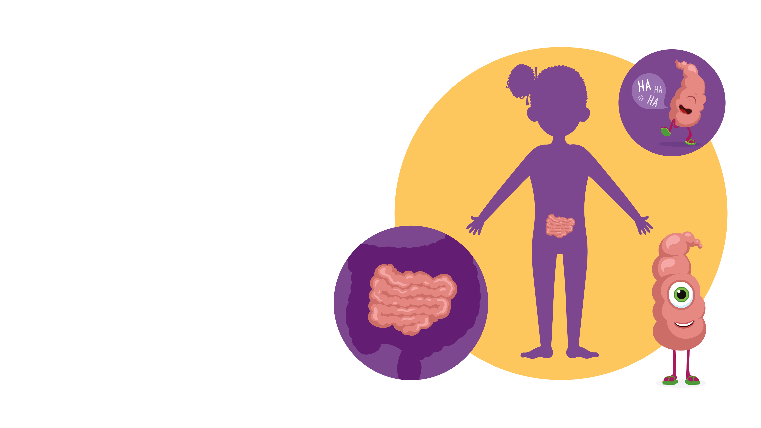
Meet Small Bowel
Also known as your small intestine, but this mighty organ isn’t small at all, measuring
6 metres from one end to the other, which
is about four times as tall as you are.
Small Bowel carries food from your up
(or absorbing) important nutrients along
the way.
Did you know?
It’s the happy factory! Most of
your serotonin (which is the hormone
that makes you feel happy) is made
by your small bowel.
Orgamites ® is an organ donation education and awareness programme created by Roydon Turner. Creative and production by All Good Co. (CIC) © Copyright 2016. All rights reserved.
Orgamites ® is an organ donation education and awareness programme created by Roydon Turner. Creative and production by All Good Co. (CIC) © Copyright 2016. All rights reserved.
TK1: LESSON PRESENTATION
Notes:
Ask pupils where they think the small intestine (small bowel) is located in the human body.
Further information
The intestines or bowel is part of the digestive system. It is made up of the small intestine (small bowel) and the large intestine (colon and rectum).
The small intestine is a long and winding tube in your abdomen which carries food from your stomach to your large intestine. It gets its name because of its small width (or diameter), but it is actually very long, it is just tightly folded inside your abdomen. The small intestine is where most digestion takes place and where nutrients from food get absorbed into your body. Food spends up to four hours in the small intestine while the nutrients are absorbed into the blood.
Did you know?
The small intestine is made up of three different parts, called the ileum, jejunum and duodenum.

Slide 10
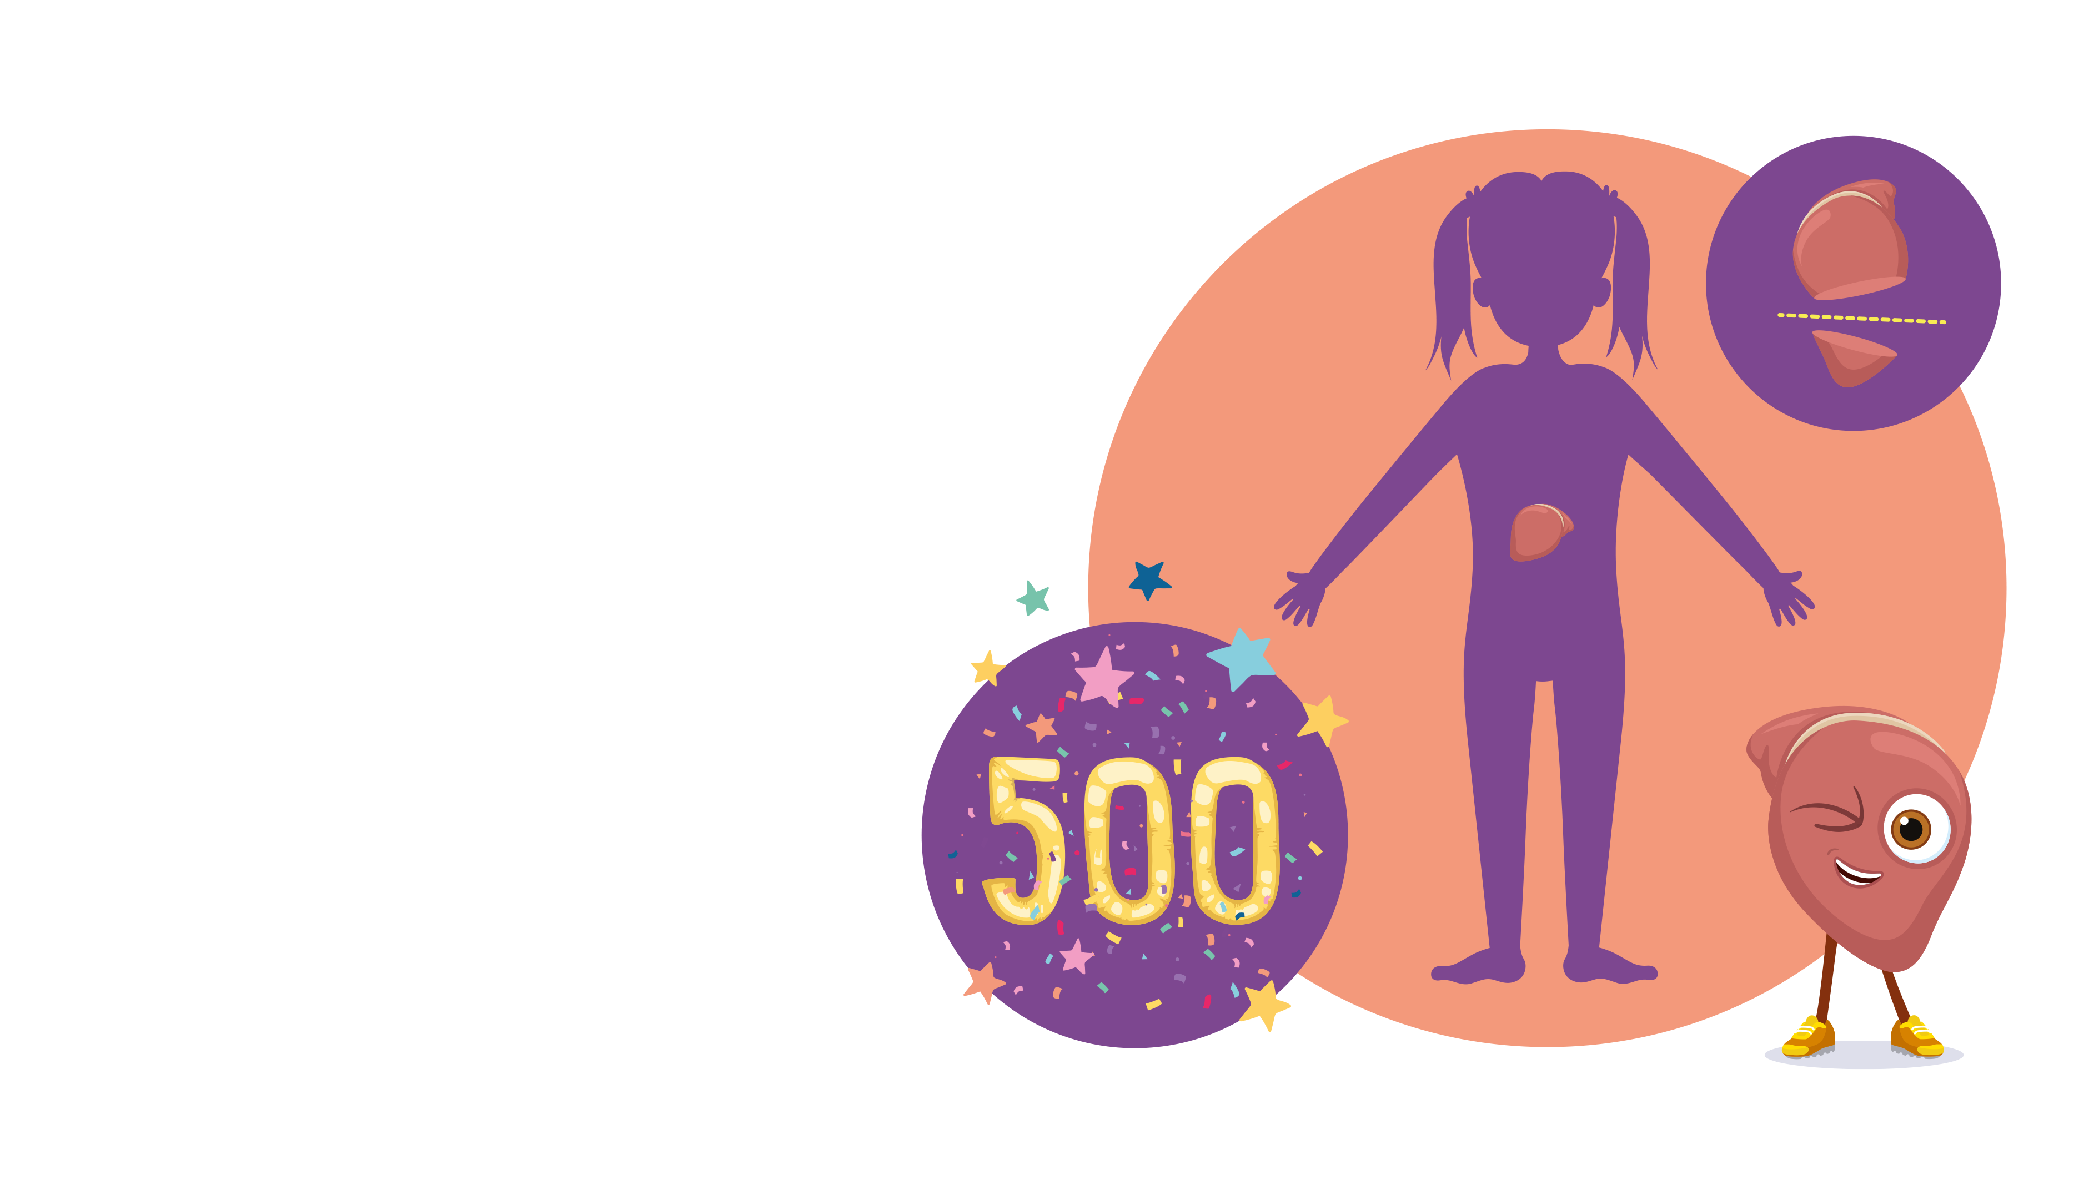
Meet Liver
Say hello to the real multi-tasker sitting
in your middle...This mighty organ is the heaviest organ inside your body and one
of the busiest, with over 500 jobs to do
Liver also cleans your blood, builds up
your energy stores, helps your kidneys
slows down and encourages your
bowels to speed up.
Did you know?
It can grow back! Just a quarter of
your liver can ‘re-grow’ to its original
size within a few weeks!
Orgamites ® is an organ donation education and awareness programme created by Roydon Turner. Creative and production by All Good Co. (CIC) © Copyright 2016. All rights reserved.
Orgamites ® is an organ donation education and awareness programme created by Roydon Turner. Creative and production by All Good Co. (CIC) © Copyright 2016. All rights reserved.
TK1: LESSON PRESENTATION
Notes:
Ask pupils where they think the liver is located in the human body.
Further information
The liver is the largest internal organ. Reddish-brown in colour, it feels rubbery to touch and sits on the right side of the belly protected by the rib cage. Every vertebrate (any animal with a backbone) has a liver.
The liver works with the pancreas and the intestines to digest, absorb and process food.
It’s three main jobs are to clean the blood, produce bile (which helps to break down food) and store energy.
Did you know?
The liver has an amazing ability for regrowth. A quarter of the liver can ‘regrow’ to its original size!

Slide 11
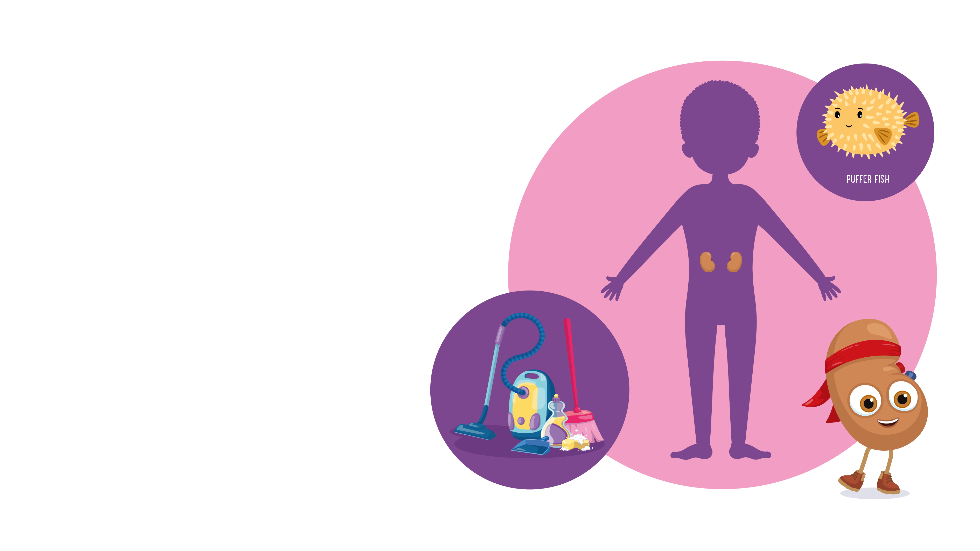
Meet Kidney
You have two of these mighty legends, and together, they kick all the toxic waste right out of your bloodstream.
Your kidneys not only filter your blood but also maintain the perfect water balance, otherwise you’d swell up like a puffer fish or shrivel
up like a prune!
Did you know?
Some people have just one kidney.
If a kidney is taken out or damaged,
the remaining kidney works even
harder and can still keep you healthy
and happy.
Orgamites ® is an organ donation education and awareness programme created by Roydon Turner. Creative and production by All Good Co. (CIC) © Copyright 2016. All rights reserved.
Orgamites ® is an organ donation education and awareness programme created by Roydon Turner. Creative and production by All Good Co. (CIC) © Copyright 2016. All rights reserved.
TK1: LESSON PRESENTATION
Notes:
Ask pupils where they think the kidneys are located in the human body.
Further information
These bean-shaped organs come in pairs and are found towards your back, in the upper part of the tummy (called the abdomen). They are a little bigger than your first and do a lot of different jobs, their most important job is to filter waste products from the blood and make this into urine. Kidneys also produce a hormone that tells the body to make red blood cells.
Although they usually come in pairs, some people have just one kidney. This can be for different reasons; because they were only born with one, because one of their kidneys has been damaged or because they have donated (or given) one of their kidneys to someone else.
Did you know?
Drinking enough water is a good way to help your kidneys to work properly.

Slide 12
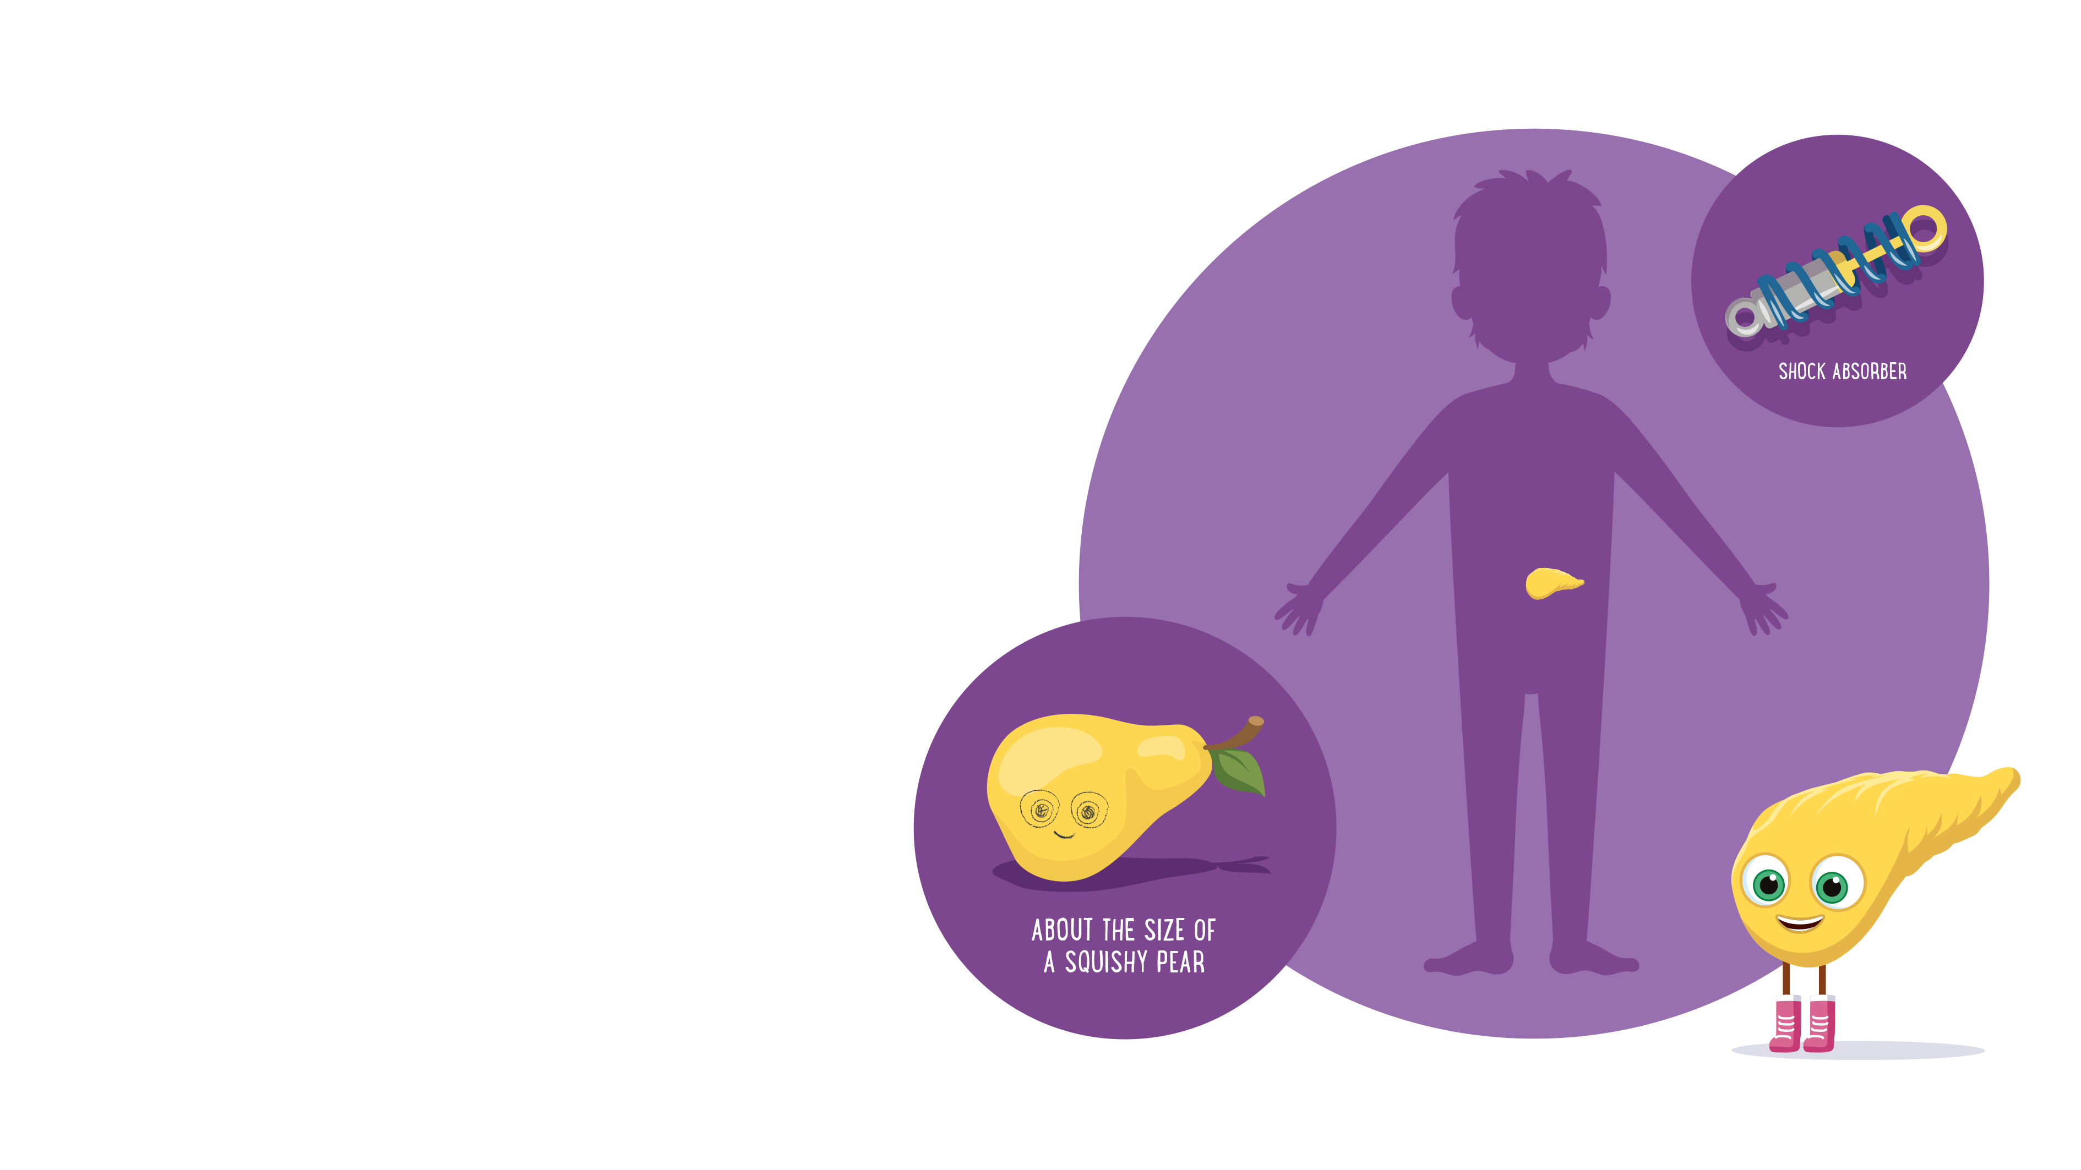
Meet Pancreas
Say hello to Pancreas – your most loyal
(and laid-back) supporter. Small, flat, and
about the size of a squishy pear!
This shy superhero produces essential digestive juices and making sure your
blood sugar levels are stable so that
you have energy throughout the day.
Did you know?
Up until the 19th century, doctors
believed that the pancreas was simply
a fancy-shaped shock absorber to
protect your stomach!
Orgamites ® is an organ donation education and awareness programme created by Roydon Turner. Creative and production by All Good Co. (CIC) © Copyright 2016. All rights reserved.
Orgamites ® is an organ donation education and awareness programme created by Roydon Turner. Creative and production by All Good Co. (CIC) © Copyright 2016. All rights reserved.
TK1: LESSON PRESENTATION
Notes:
Ask pupils where they think the pancreas is located in the human body.
Further information
The pancreas is found in the upper part of the tummy (called the abdomen). It is positioned behind the stomach and in front of the spine. It is about 15cm long and is surrounded by other organs, like the liver and small intestine (small bowel).
The pancreas is important for digestion. When food enters your stomach, the pancreas releases special digestive juices which are sent to the small intestine to help break down food.
Did you know?
Your pancreas produces 6 to 8 cups of digestive juices every day!

Slide 13
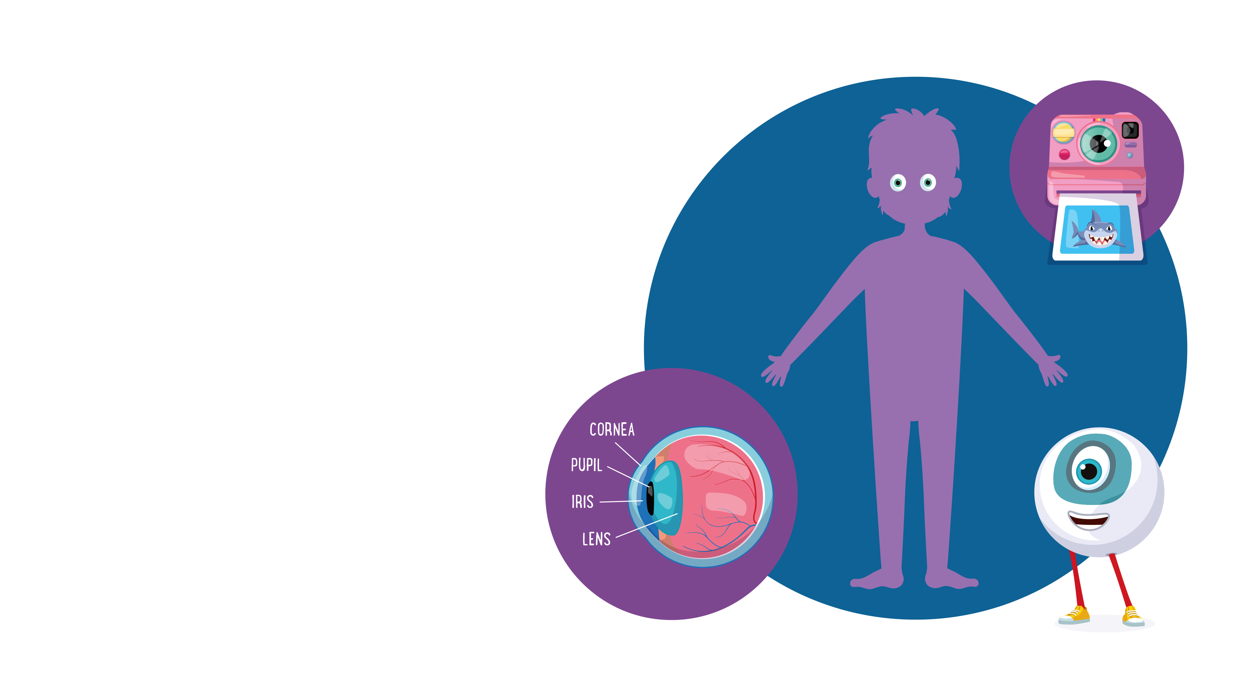
Meet Eye
Introducing the ultimate observer, Eye.
Like a super-advanced (and very slippery) camera, made up of more than two million different parts, it lets in light and sends messages to our brain, allowing you to see.
Did you know?
Something’s fishy... A shark’s eye
is a lot like ours! They're so similar
that sometimes doctors use shark
corneas for human eye surgery!
Orgamites ® is an organ donation education and awareness programme created by Roydon Turner. Creative and production by All Good Co. (CIC) © Copyright 2016. All rights reserved.
Orgamites ® is an organ donation education and awareness programme created by Roydon Turner. Creative and production by All Good Co. (CIC) © Copyright 2016. All rights reserved.
TK1: LESSON PRESENTATION
Notes:
Further information
The eye is made up of lots of different parts, which work together to help us see the world around us.
The parts of the eye include:
the retina – the surface of the eyeball, the retina is made up of special cells which detect light and send messages to our brain to help us see
the cornea – think of this as the ‘window’ of the eye. It’s the clear tissue at the front of your eye which lets light in (the bit of your eye that you could touch)
the pupil – looks like a black dot, but is actually a hole through which light (having passed through the cornea) can enter the eye
Did you know?
The cells in your eye come in different shapes. Rod-shaped cells help you to see shapes, and cone-shaped cells help you to see colour.

Slide 14

Activity 1:
‘Jobs of the organs’
In your pairs match the organ
with its function.
Orgamites ® is an organ donation education and awareness programme created by Roydon Turner. Creative and production by All Good Co. (CIC) © Copyright 2016. All rights reserved.
TK1: LESSON PRESENTATION
Notes:
Refer to Additional Teacher Resources: Activity #1 (pages 4-5)

Slide 15
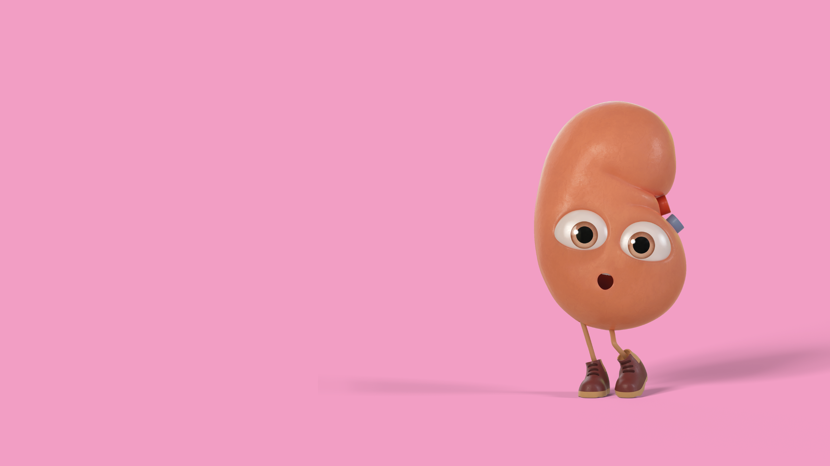
When organs stop working...
What might happen if someone’s organs
are not working properly?
Orgamites ® is an organ donation education and awareness programme created by Roydon Turner. Creative and production by All Good Co. (CIC) © Copyright 2016. All rights reserved.
TK1: LESSON PRESENTATION
Notes:
Explain that sometimes a person’s organ might not work properly.
An organ that isn’t doing its job can cause all kinds of difficulties.
For example if a person’s eye isn’t working properly, they might have limited vision or lose their sight completely.
Or if a person’s kidneys aren’t doing their job, then their blood won’t be cleaned. Extra fluid can build up in the blood which can lead to things like nausea and weakness.
If a person’s bone marrow isn’t making the right blood cells, their blood won’t be able to do its important jobs like carrying oxygen and energy around the body or helping to fight disease.

Slide 16
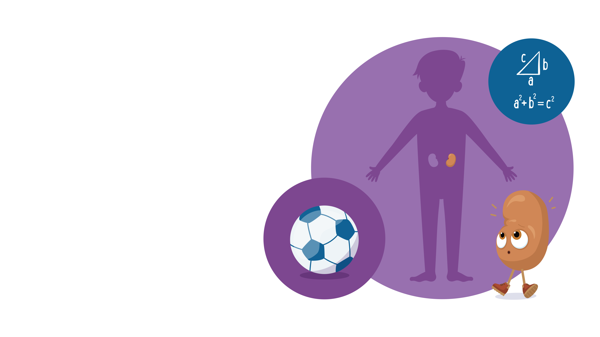
When organs stop working...
Meet Daniel
Age: 20
Favourite subject at school: Maths
Likes: Football, cool clothing and
going to the movies with friends.
Daniel became unwell because his
kidneys stopped working properly.
It made him feel very tired and he
had to visit the hospital a lot.
Because he felt unwell, it made
it difficult for Daniel to do all the
activities he liked.
Watch Daniel’s video here
Orgamites ® is an organ donation education and awareness programme created by Roydon Turner. Creative and production by All Good Co. (CIC) © Copyright 2016. All rights reserved.
TK1: LESSON PRESENTATION
Notes:
Share the story of Daniel with pupils and ask them the following discussion questions:
1. Which organ did Daniel need?
2. How has his donated organ improved Daniel’s life? (Think about what he can now do that he couldn’t do before)
3. How do you think Daniel feels to have received a kidney transplant?
Note: Daniel is a real-life story. The experiences and symptoms described are true of real people awaiting an organ transplant.

Slide 17
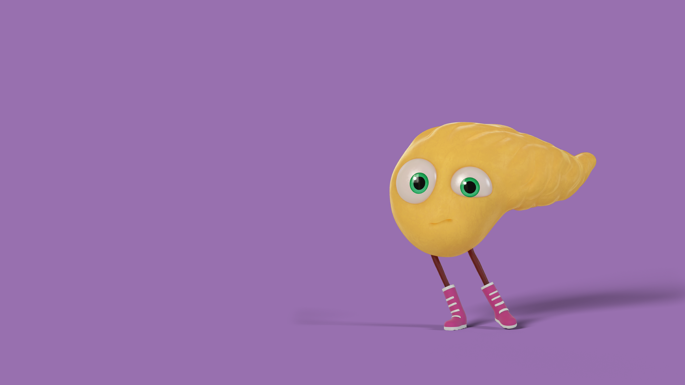
Activity 2:
‘Comparison activity’
In your groups - compare what
life was like for Daniel before
and after getting a new kidney.
Orgamites ® is an organ donation education and awareness programme created by Roydon Turner. Creative and production by All Good Co. (CIC) © Copyright 2016. All rights reserved.
TK1: LESSON PRESENTATION
Notes:
Refer to Additional Teacher Resources: Activity #2 (page 6)

Slide 18
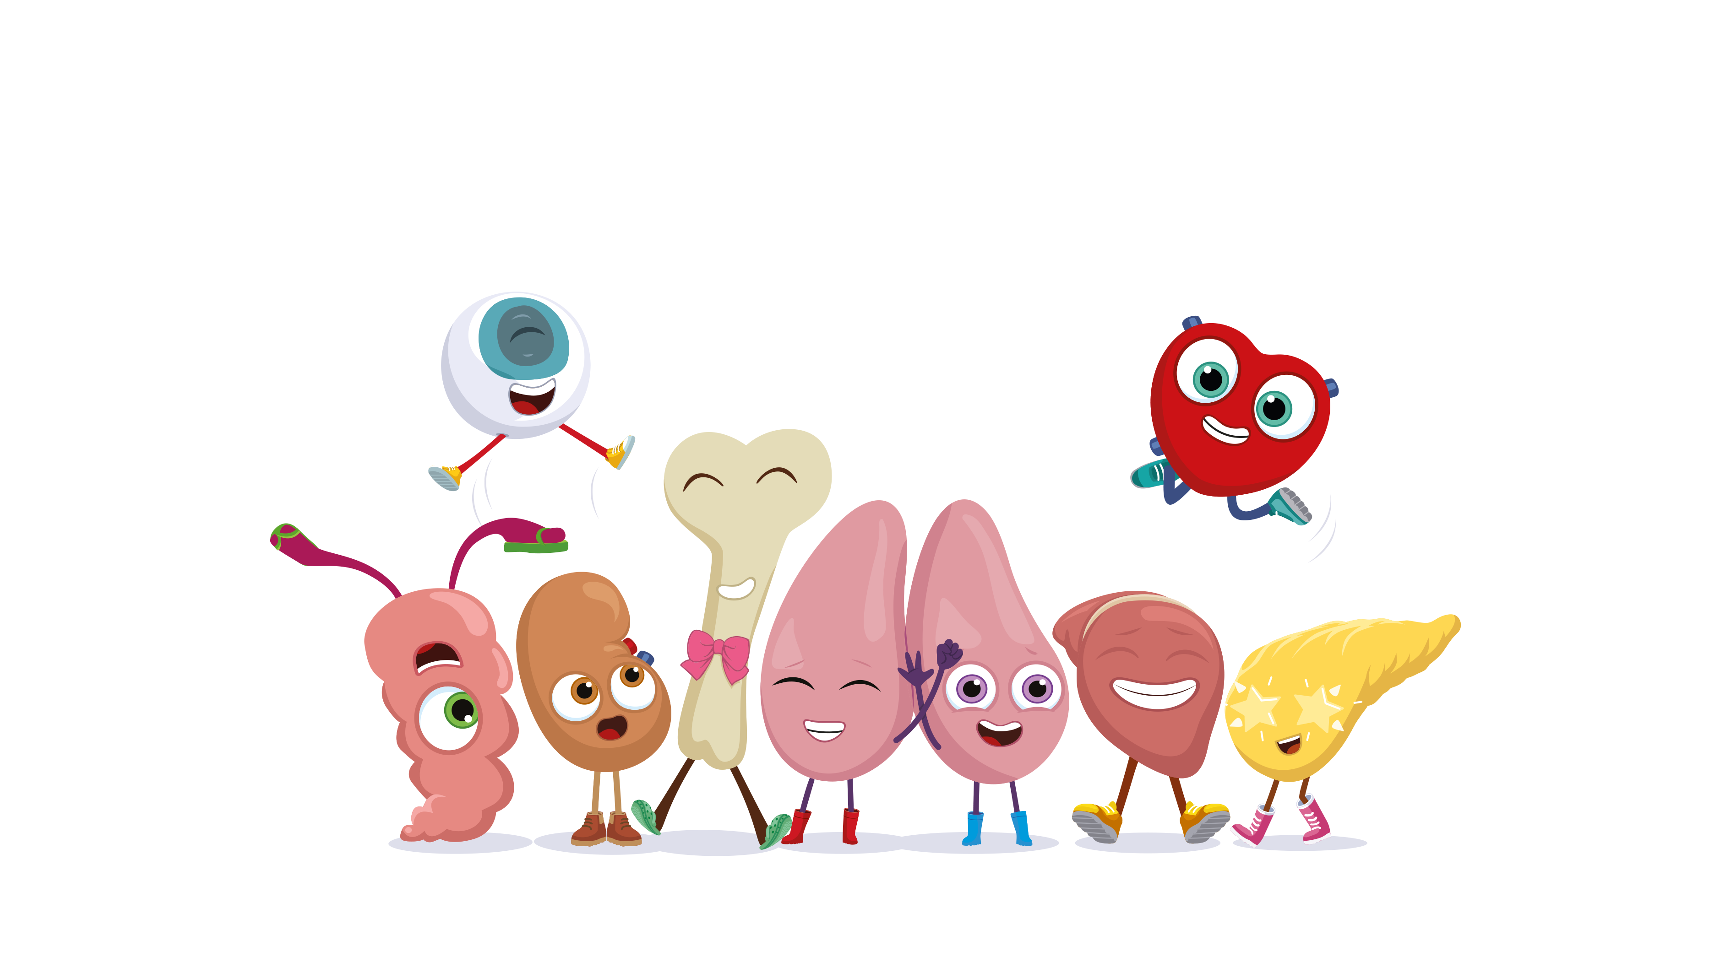
What have we learned today?
Orgamites ® is an organ donation education and awareness programme created by Roydon Turner. Creative and production by All Good Co. (CIC) © Copyright 2016. All rights reserved.
TK1: LESSON PRESENTATION

Slide 19
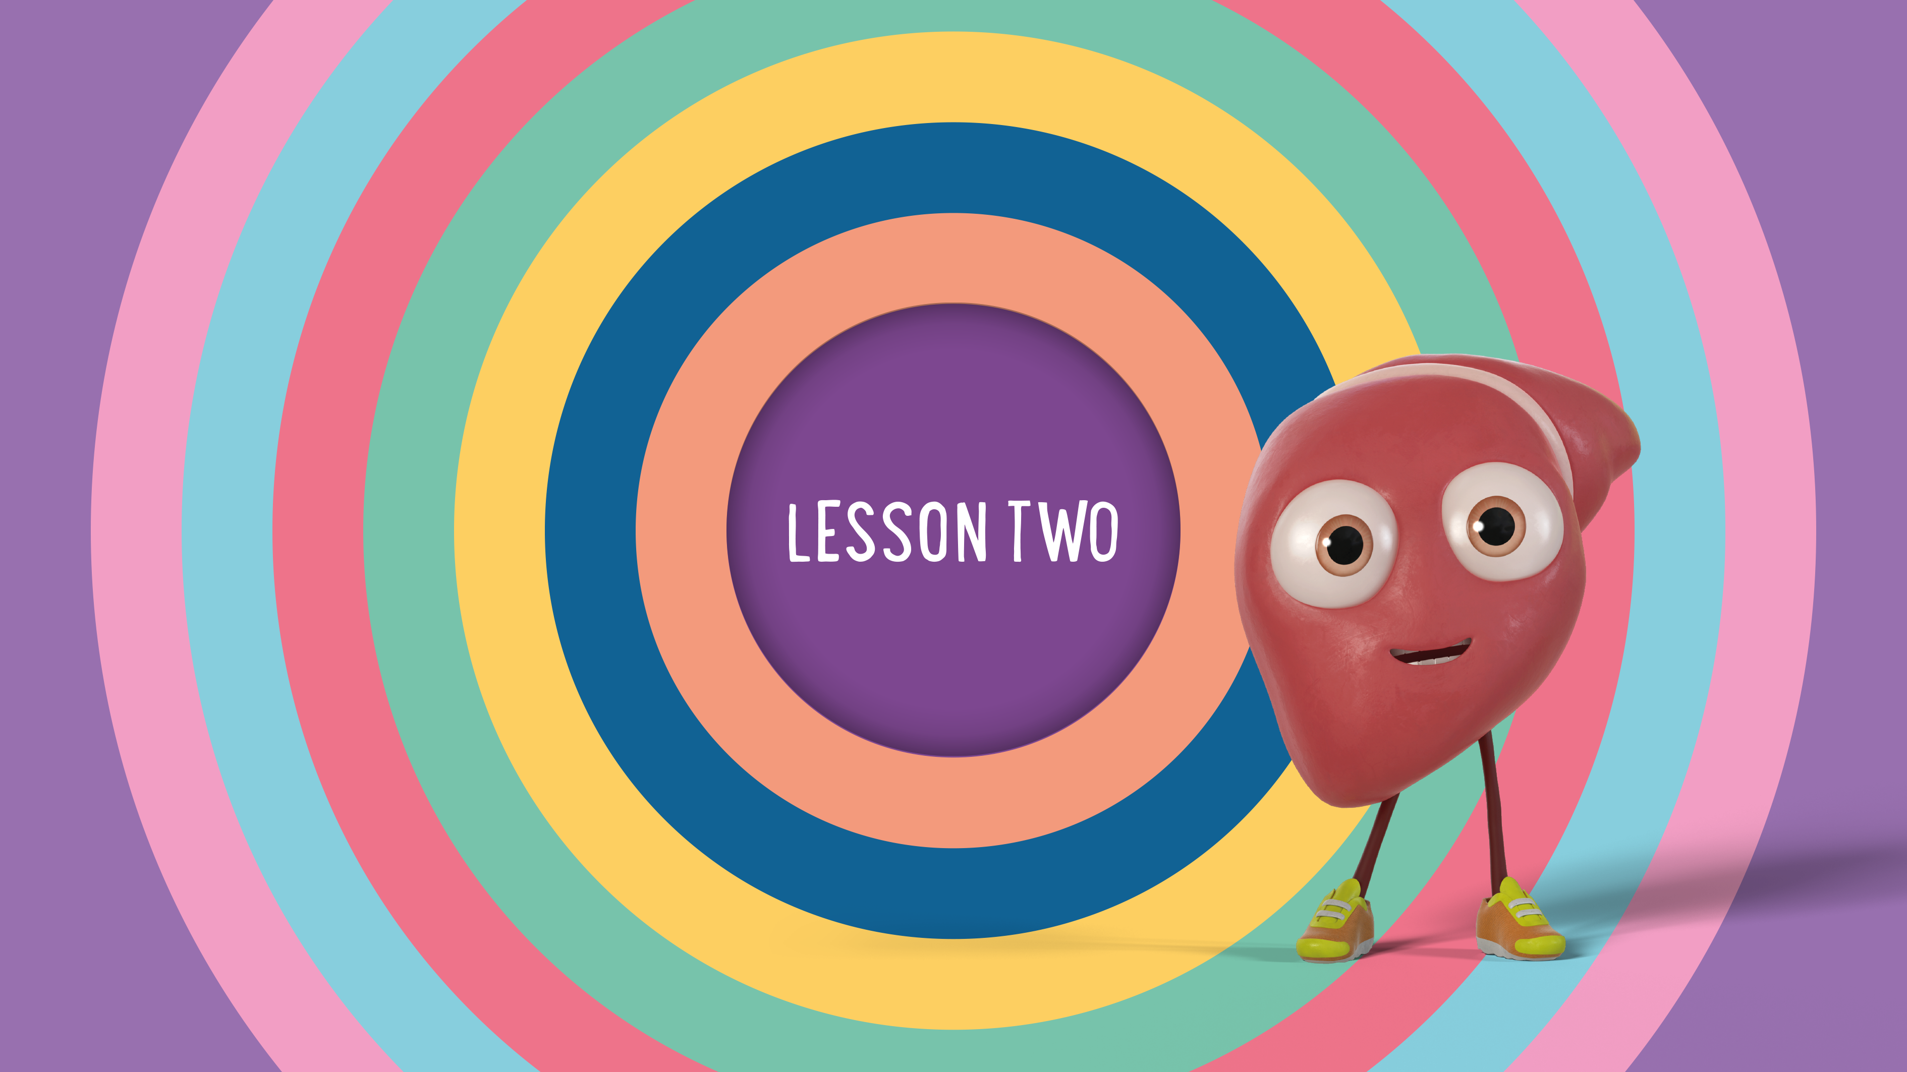
Orgamites ® is an organ donation education and awareness programme created by Roydon Turner. Creative and production by All Good Co. (CIC) © Copyright 2016. All rights reserved.
TK1: LESSON PRESENTATION
Notes:
Refer to Lesson Plan notes page 4

Slide 20

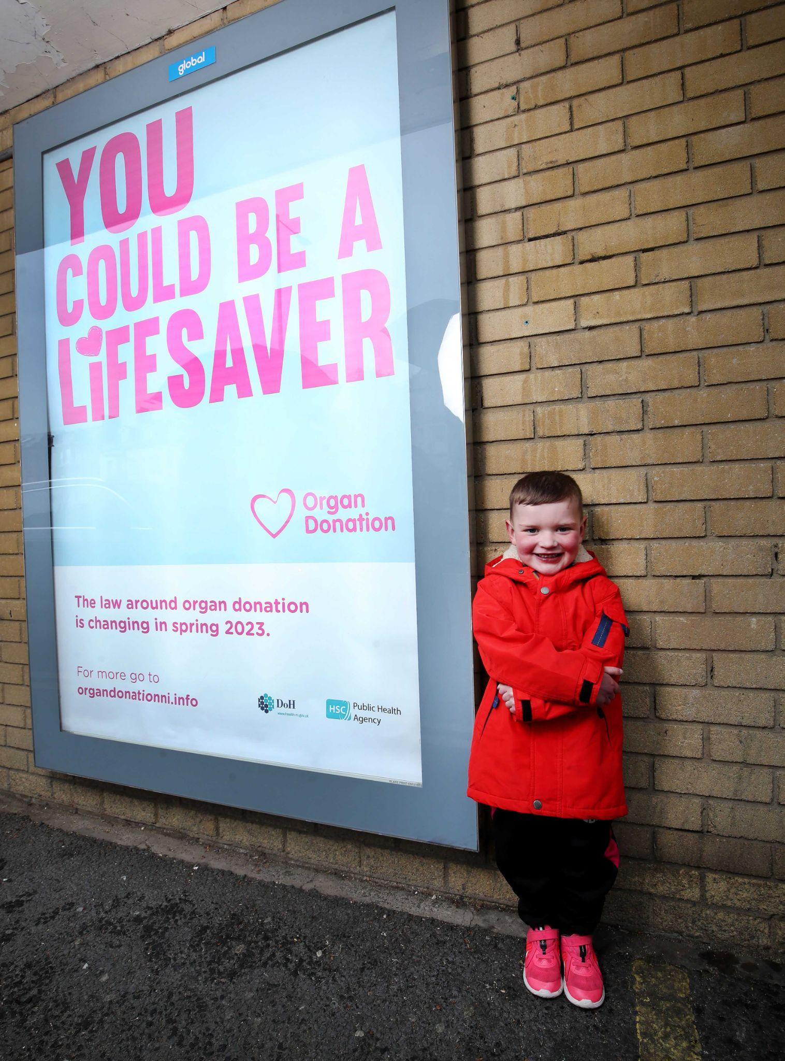
Meet Dáithí
Dáithí Mac Gabhann was born with
a heart condition which means his
heart doesn’t work properly.
This means, Dáithí needs a heart
transplant to help him feel better.
Dáithí has been waiting for the gift
of a new heart for nearly his whole life.
Watch Dáithí’s video here
Dáithí beside a poster to help raise awareness of Dáithí’s Law
Orgamites ® is an organ donation education and awareness programme created by Roydon Turner. Creative and production by All Good Co. (CIC) © Copyright 2016. All rights reserved.
TK1: LESSON PRESENTATION

Slide 21
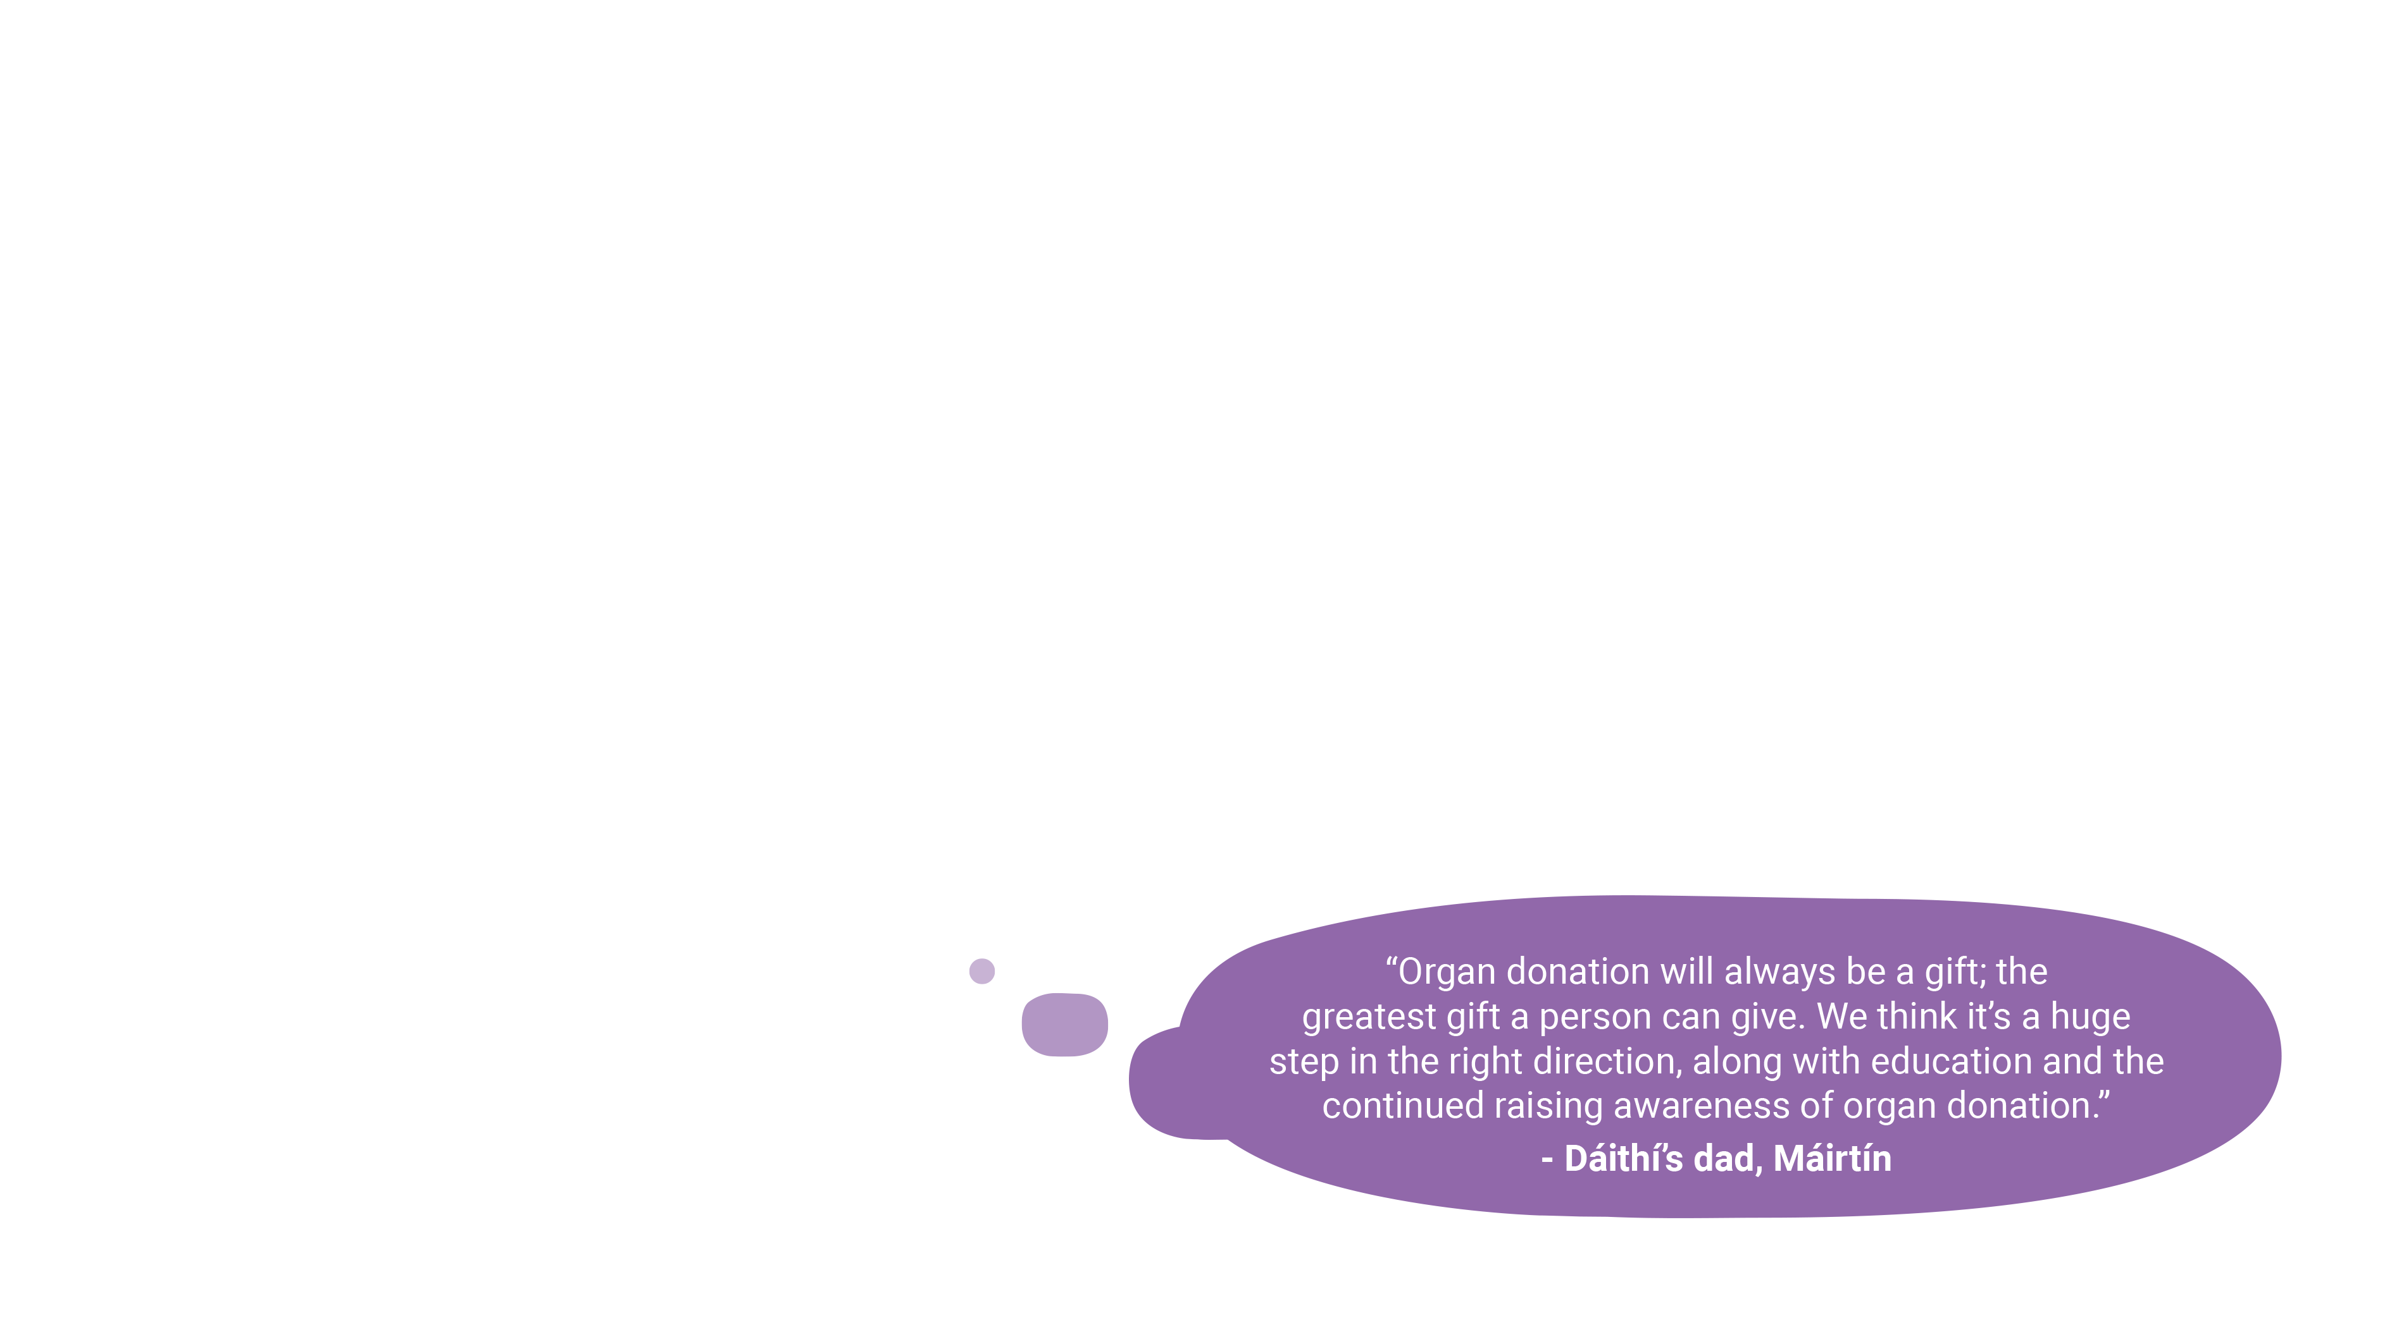
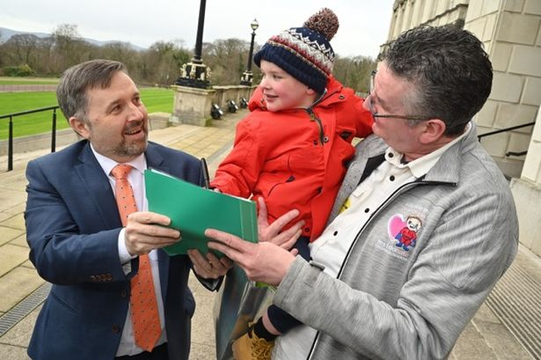
What is Dáithí’s Law?
‘Dáithí's Law’ is named after 6-year-old
organ donation campaigner Dáithí Mac Gabhann, who has been waiting for
the gift of a new heart since he was one.
The new law changed the system
of organ donation in Northern Ireland
to an opt-out system. This means
everyone is presumed to be an
organ donor unless they opt out.
Dáithí and his Grandad with NI Health Minister Robin Swann
Orgamites ® is an organ donation education and awareness programme created by Roydon Turner. Creative and production by All Good Co. (CIC) © Copyright 2016. All rights reserved.
TK1: LESSON PRESENTATION
Notes:
Explain that Dáithí's Law was inspired by organ donation campaigners like Dáithí Mac Gabhann and his family. This story showed people how important organ donation is. The law changed on 1 June 2023.
Dáithí's law means all adults (anyone over 18 who lives in Northern Ireland) will be seen as having agreed to be an organ donor, unless they have recorded a decision not to donate or are in an excluded group. (For more information for teachers about this law, visit www.organdonationni.info/changes-to-the-law)
Ask pupils why they think the government wanted to change the law around organ donation?
For example, because:
they think the waiting list for organs is too long and they want to help those people waiting
they were inspired by the stories of organ donation campaigners like Dáithí Mac Gabhann
Ask pupils what they think about this change in the law?
Encourage pupils to reflect on everything that they have learned in the lesson and explain their thinking.
Organ donation and ethnicity
People who are from black, Asian ethnic groups have to wait longer to receive an organ. This is for lots of different reasons, including the fact that some organ diseases are more common in these groups and that often they need to have a donor from the same ethnic background as them.

Slide 22

What is organ donation?
This means that if a person’s mighty organs
stop working or aren’t working well, doctors
can replace them with new ones from
another person (called an organ donor).
The operation that makes this possible is
called an organ transplant.
Orgamites ® is an organ donation education and awareness programme created by Roydon Turner. Creative and production by All Good Co. (CIC) © Copyright 2016. All rights reserved.
TK1: LESSON PRESENTATION
Notes:
Luckily, doctors can perform something called an organ transplant. This is when the doctors replace a failed or damaged organ with a healthier one.
However, to do this, doctors need to have donated organs – organs that are given from one person to another.
A person can sign up to a special register to say they want to donate their organs (and they can sign up to say they don’t want to donate them too!).
At the moment, there are around 6,000 people on the transplant waiting list in the UK – this means they are waiting for an organ donation that could save their lives.

Slide 23
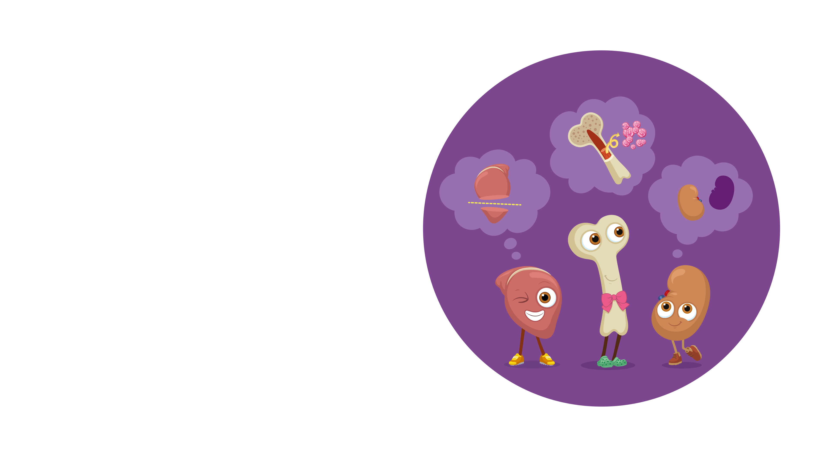
What is a Living Donor?
A living donor is usually a grown-up and often
a family member, who shares a healthy part of their body with someone who is sick to help them get better.
Orgamites ® is an organ donation education and awareness programme created by Roydon Turner. Creative and production by All Good Co. (CIC) © Copyright 2016. All rights reserved.
TK1: LESSON PRESENTATION
Notes:
Explain that all the organs we have learned about today can be donated from one person to another.
A person can agree to donate their organs after they die but there are also some organs that can be donated when a person is living.
Ask pupils which organs they think can be donated by living donors? Click to reveal the answers (bone marrow, liver, kidneys)
Further information on living organ donation
Remember the odd one out, bone marrow? If a living person wants to donate their bone marrow, there is a special donation register they can sign up to.
Part of someone’s liver can also be donated – remember that the liver has an amazing ability for regrowth. Just a quarter of the liver can ‘regrow’ to its original size! This means that just a small part of a healthy liver could grow into a whole healthy liver for the person who receives the organ (the recipient). And the organ donor’s liver will regrow as well.

Slide 24
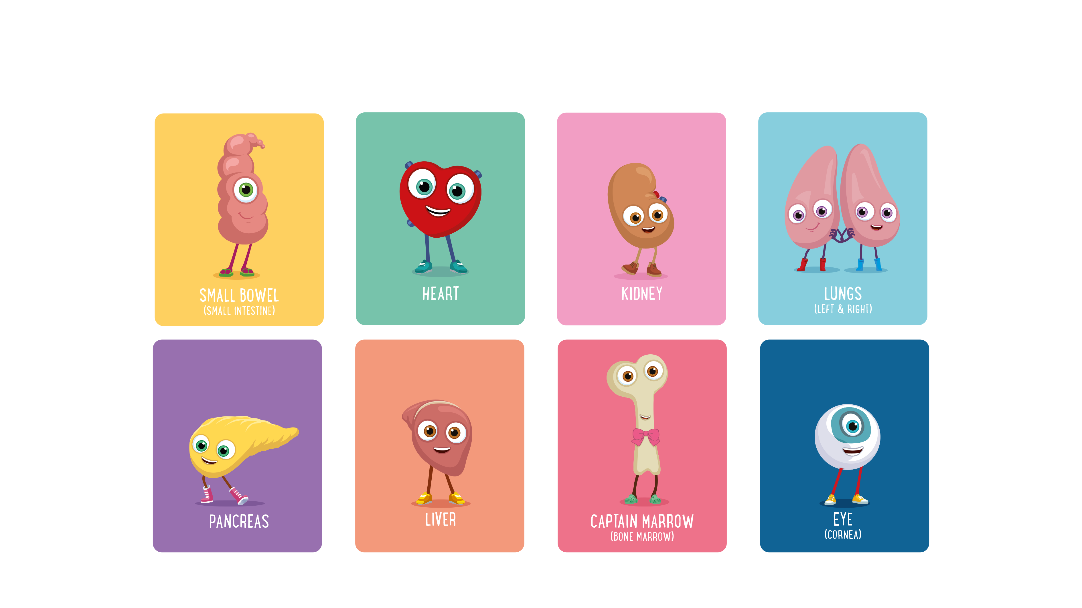
Which organs might be donated by a living donor?
Orgamites ® is an organ donation education and awareness programme created by Roydon Turner. Creative and production by All Good Co. (CIC) © Copyright 2016. All rights reserved.
TK1: LESSON PRESENTATION
Notes:
Explain that all the organs we have learned about today can be donated from one person to another.
A person can agree to donate their organs after they die but there are also some organs that can be donated when a person is living.
Ask pupils which organs they think can be donated by living donors? Click to reveal the answers (bone marrow, liver, kidneys)
Further information on living organ donations
Remember the odd one out, bone marrow? If a living person wants to donate their bone marrow, there is a special donation register they can sign up to.
Part of someone’s liver can also be donated – remember that the liver has an amazing ability for regrowth. Just a quarter of the liver can ‘regrow’ to its original size! This means that just a small part of a healthy liver could grow into a whole healthy liver for the person who receives the organ (the recipient). And the organ donor’s liver will regrow as well.

Slide 25
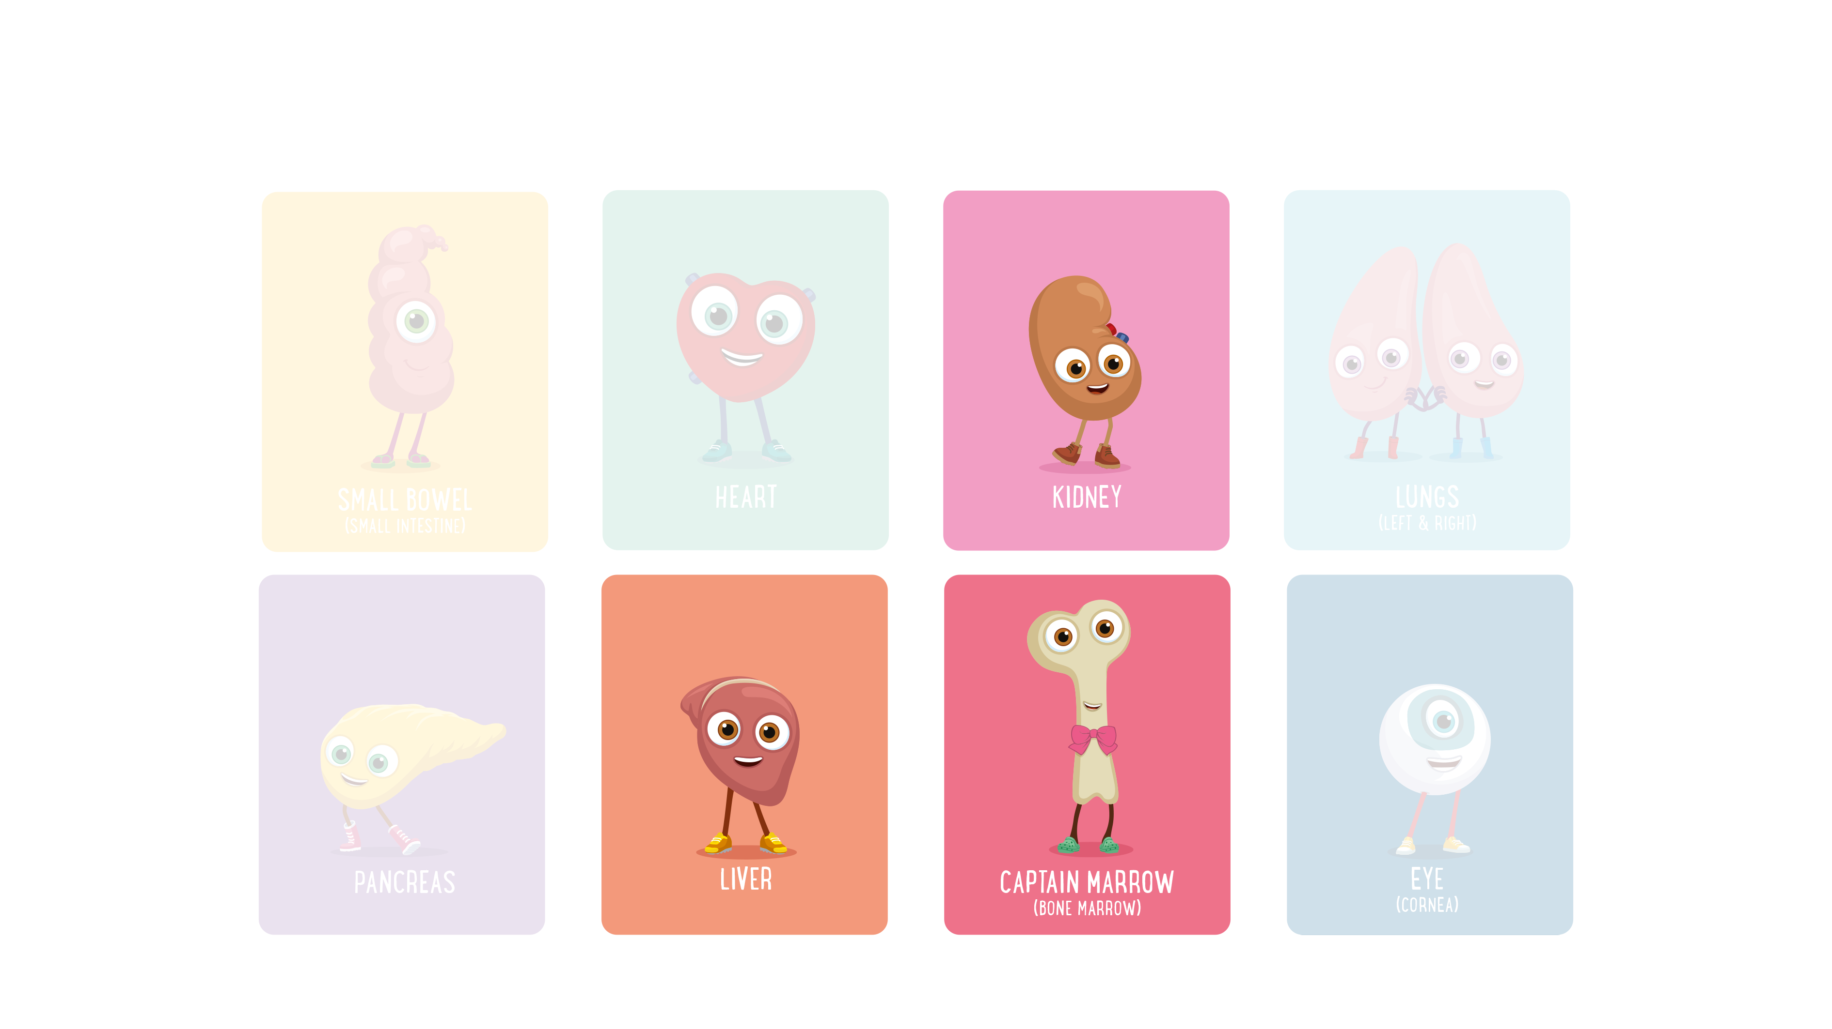
Which organs might be donated by a living donor?
Orgamites ® is an organ donation education and awareness programme created by Roydon Turner. Creative and production by All Good Co. (CIC) © Copyright 2016. All rights reserved.
TK1: LESSON PRESENTATION
Notes:
Explain that all the organs we have learned about today can be donated from one person to another.
A person can agree to donate their organs after they die but there are also some organs that can be donated when a person is living.
Ask pupils which organs they think can be donated by living donors? Click to reveal the answers (bone marrow, liver, kidneys)
Further information on living organ donations
Remember the odd one out, bone marrow? If a living person wants to donate their bone marrow, there is a special donation register they can sign up to.
Part of someone’s liver can also be donated – remember that the liver has an amazing ability for regrowth. Just a quarter of the liver can ‘regrow’ to its original size! This means that just a small part of a healthy liver could grow into a whole healthy liver for the person who receives the organ (the recipient). And the organ donor’s liver will regrow as well.

Slide 26
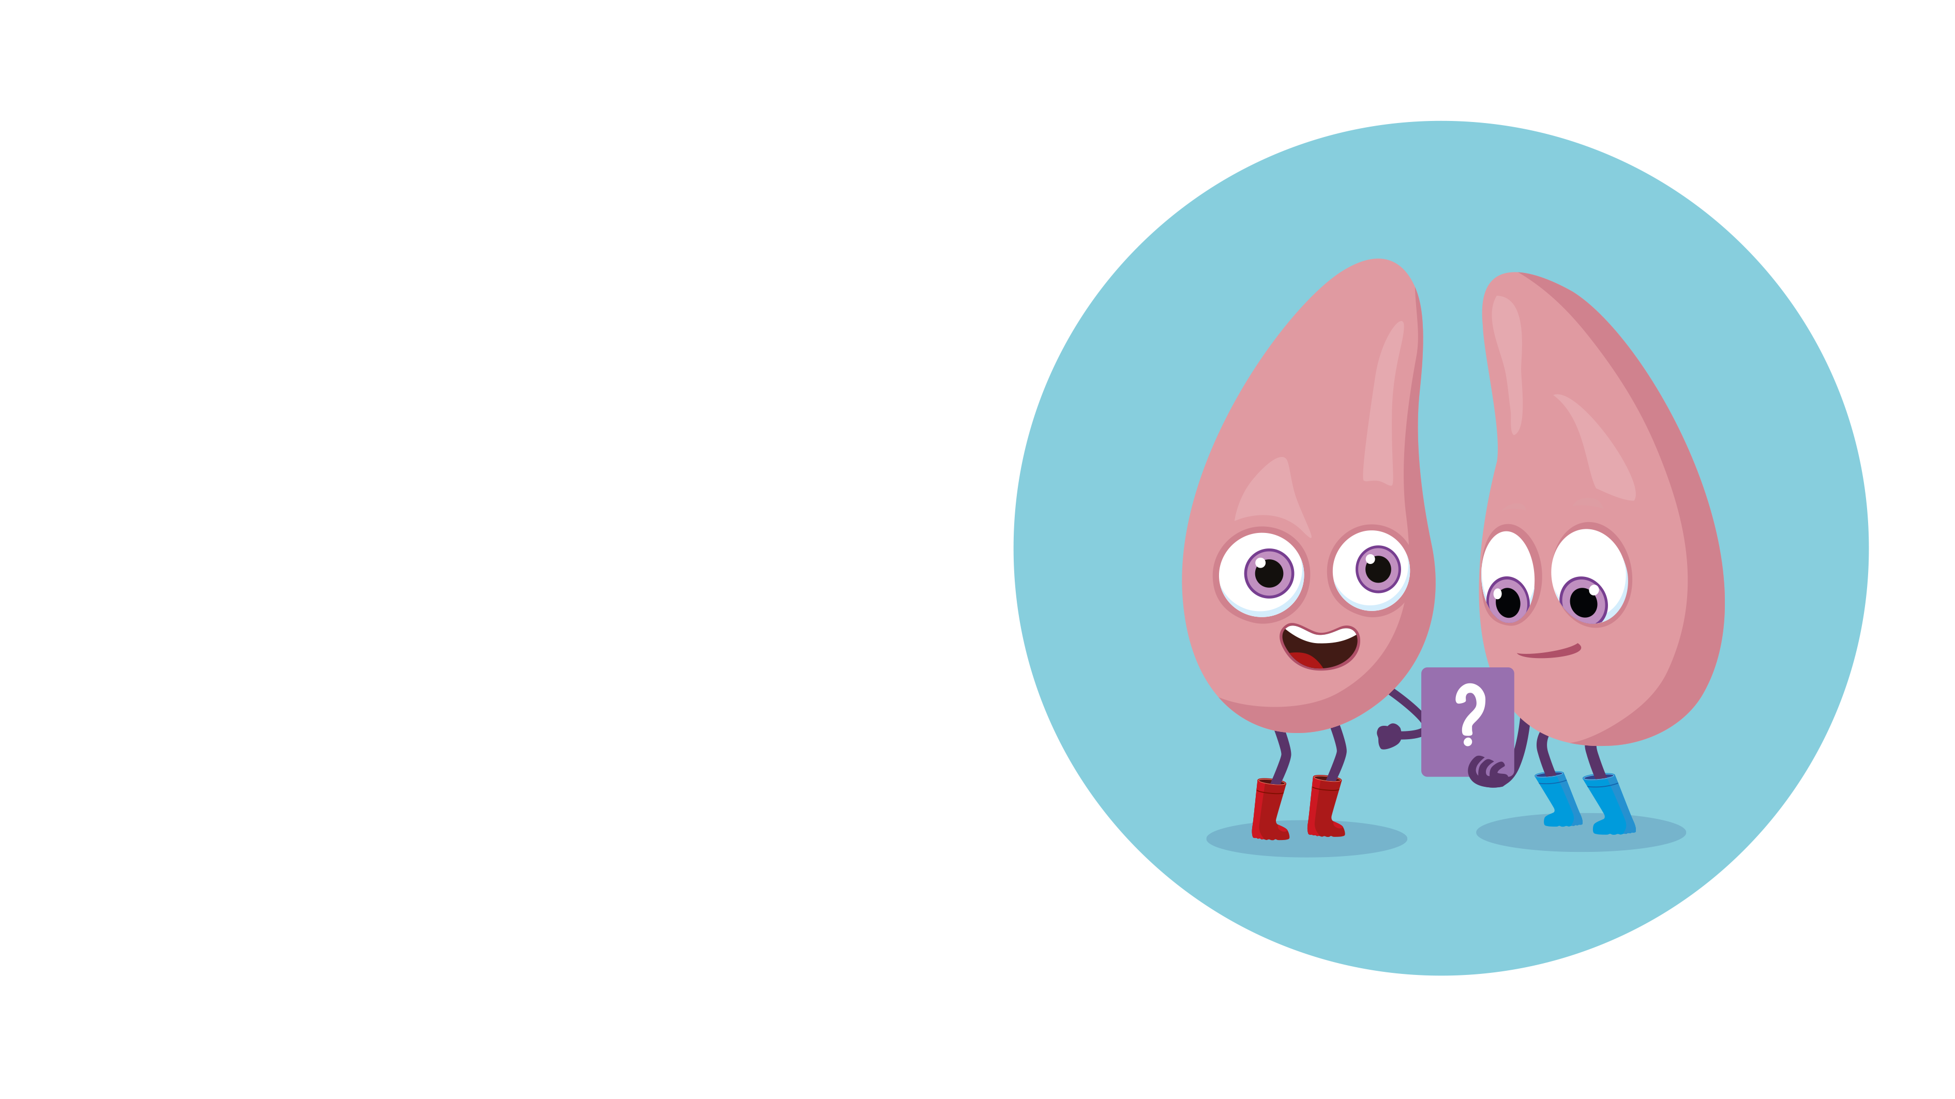
Questions to think about
Why might someone choose to donate their organs?
Why might someone not want to donate their organs?
Orgamites ® is an organ donation education and awareness programme created by Roydon Turner. Creative and production by All Good Co. (CIC) © Copyright 2016. All rights reserved.
TK1: LESSON PRESENTATION
Notes:
Ask pupils to discuss the question on the board (click to reveal): Why might someone choose to donate their organs?
Possible answers might include:
to know they are helping other people
because they don’t need them anymore if they are no longer living
because they would want others to have donated organs if they or their loved ones needed an organ
Ask pupils to discuss the second question (click to reveal): Why might some people not want to donate their organs?
Possible answers might include:
they don’t know much about it and what is involved
they think they have to donate all of their organs (this is not true – you can choose which ones you want to donate and which you don’t)
they think there are enough organs being donated already
they are scared of the idea (which might come from not knowing much about it)
they think their religion doesn’t support it (explain that most religions in the UK support the idea of organ donation)
Sometimes a person will have chosen to donate their organs but their family don’t know about their choice and so their organs don’t end up being donated.
It is really important for people to continue to talk about their choice with those closest to them, so that their family can honour that choice.

Slide 27
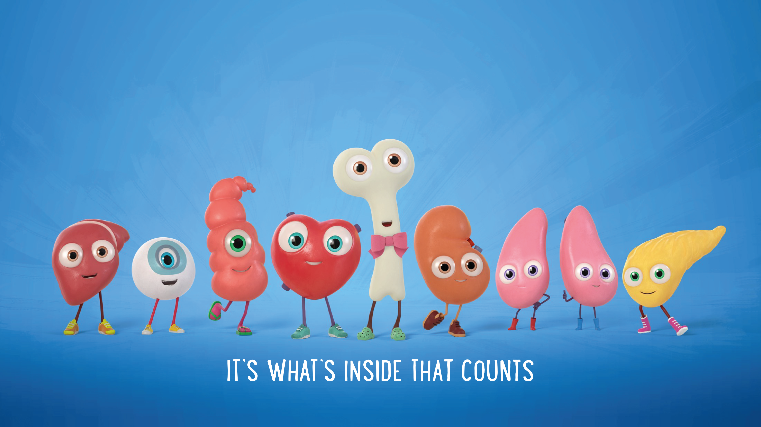
Talk to your family about what
you have learned today!
Orgamites ® is an organ donation education and awareness programme created by Roydon Turner. Creative and production by All Good Co. (CIC) © Copyright 2016. All rights reserved.
TK1: LESSON PRESENTATION
Notes:
Explain that having a talk with family and friends about organ donation is important – it’s a good way to make sure your family know what your choice is and that you know theirs!
Talking about organ donation helps people to honour one another’s choices.
Give pupils Take Home Activities 1-3, and the colouring-in sheet from the Additional Teachers Resources, to continue their learning at home:
Take Home Activity #1 – A Family Challenge
Take Home Activity #2 – Can You Name The Mighty Organs?
Take Home Activity #3 – Family Tree
Orgamites Colouring-in Sheet

Slide 28
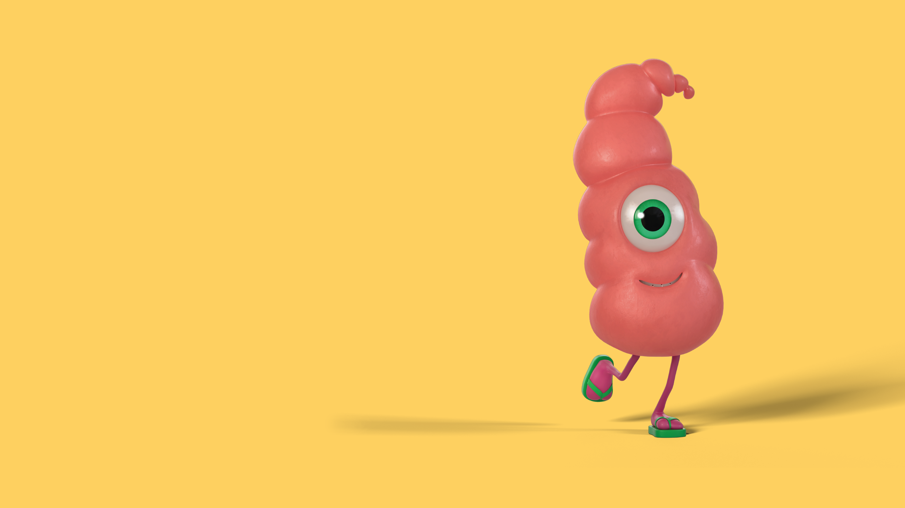
Teacher’s notes
N.B. Teachers’ notes and background information can only be viewed if this presentation is opened within the PowerPoint application, not on interactive whiteboards.
The visuals on the PowerPoint slides display
best in PowerPoint presentation mode
.
Orgamites ® is an organ donation education and awareness programme created by Roydon Turner. Creative and production by All Good Co. (CIC) © Copyright 2016. All rights reserved.
TK1: LESSON PRESENTATION

Slide 29
Teachers’ further information
Dáithí’s Law
Dáithí’s law (introduced in Northern Ireland from Spring 2023) is a ‘deemed consent’ system similar to the system that already exists in Wales and England.
Here are some key things you need to know:
You will still have a choice if you want to be an organ donor or not when you die
You can choose to opt in or opt out by recording your decision on the NHS Organ Donor Register
Your family will still be consulted about organ donation
Any questions about the process will be addressed, including how your faith, beliefs or culture will be respected
Whatever you decide, tell your family and friends to help ensure your decision is honoured
To find out more, visit www.organdonation.nhs.uk
DONATION AND THE BAME COMMUNITY
Patients from black, Asian and minority ethnic communities are more likely to need an organ transplant than the rest of the population as they are more susceptible to illnesses such as diabetes and hypertension, which may result in organ failure and the need for a transplant. On average, patients from black, Asian and minority ethnic communities wait longer for a kidney transplant, due to the lack of suitable organs. Blood and tissue types need to match for a successful organ transplant and organs from people of the same ethnic background are more likely to be a close match.

Slide 30
Teachers’ FAQs
1. WHAT IS AN ORGAN TRANSPLANT?
Doctors can sometimes perform a special operation called an organ transplant. This is when the doctors replace a failed or damaged
organ with a healthier one. For this to happen, organs need to be given or donated by organ donors.
2. WHAT IS ORGAN DONATION?
Organ donation is giving a solid organ (like a lung) or tissue (like skin) to help someone who needs a transplant.
3. WHO CAN BE AN ORGAN DONOR?
Everyone can be an organ donor – there is no age limit and those with illnesses or long-term conditions can also sign up to be donors.
Specialist healthcare professionals decide in each individual case whether a person’s organs and tissue are suitable for donation.
4. WHY DO I NEED TO SHARE MY DECISION WITH MY FAMILY?
If you die in circumstances where you are able to donate, your family will still be asked about organ donation. This is why it is so
important to share your choice with your family, whatever you decide – to help make sure your choice is honoured.
5. WHAT CAN BE DONATED?
The heart, lungs, kidneys, liver, eyes (corneas), pancreas, small intestine (small bowel) and tissues (including skin, bone and tendons) can all be donated.
6. IF YOU ARE AN ORGAN DONOR, DO YOU HAVE TO DONATE ALL YOUR ORGANS?
It is your choice. You can choose to donate some organs but not others.
7. DOES MY RELIGION SUPPORT ORGAN DONATION?
The major religions and belief systems in the UK support the principles of organ donation and understand that organ donation is an individual choice.
8. HOW IS THE LAW CHANGING IN SPRING 2023?
In Northern Ireland everyone over 18 will be considered to have agreed to be an organ donor unless they have recorded a
decision to not donate, or are in an excluded group. Talking to your family will help make sure your choice is honoured.
To find out more about your choices, and to record your decision visit www.organdonation.nhs.uk
Orgamites ® is an organ donation education and awareness programme created by Roydon Turner. Creative and production by All Good Co. (CIC) © Copyright 2016. All rights reserved.
TK1: LESSON PRESENTATION
Notes:
Please note, if you wish to share the FAQs on this slide with families, print and distribute the All about organs FAQs.

Slide 31
Teachers’ FAQs continued
9. WHY DONATE?
Donated organs save and transform thousands of lives every year in the UK. But there are still not enough organ and tissue donors and as a result there are around 6,000 people waiting for an organ transplant.
10. WILL DOCTORS WORK HARD TO SAVE MY LIFE IF I AGREE TO DONATE MY ORGANS AND/OR TISSUE?
Yes. Healthcare professionals have a duty of care to save your life first.
11. WILL THEY MAKE SURE I’M DEAD BEFORE THEY REMOVE MY ORGANS?
People can only become donors after doctors pronounce their death.
12. CAN CHILDREN AND ADULTS DONATE ORGANS TO ONE ANOTHER?
Some organs can go from adults to child, but with some organs such as heart and lungs the size of the organs needs to match and so the donor and recipient need to be in a similar age bracket.
13. DO PEOPLE WAITING FOR ORGANS ALWAYS RECEIVE THEM?
No. Every day someone dies in need of an organ transplant. A third of people waiting for a transplant are from black, Asian and minority ethnic groups. This is for lots of different reasons, including the fact that some organ diseases are more common in these groups and that often they need to have a donor from the same ethnic background as them.
14. I’VE HEARD THAT PEOPLE CAN BUY AND SELL ORGANS. IS THAT TRUE?
This is not true. The transplant laws in the UK do not allow the selling of human organs or tissue.
To find out more about your choices, and to record your decision visit www.organdonation.nhs.uk
Orgamites ® is an organ donation education and awareness programme created by Roydon Turner. Creative and production by All Good Co. (CIC) © Copyright 2016. All rights reserved.
TK1: LESSON PRESENTATION

Slide 32


